Slide 1



STATE BRIEFING
15th COMMON REVIEW MISSION
November 5th, 2022
National Health Mission, Uttar Pradesh
Venue: Mandi Parisad Bhawan 16 AP Sen Road Charbag Lucknow

Slide 2
Outline of Presentation
1. Performance and goals | 11. Nursing Cell
2. Family Planning | 12. Training
3. Maternal Health | 13. National Program
4. Child Health | 13.1 Communicable Diseases
5. RKSK | 13.2 Non Communicable Disease
6. RBSK | 14. NPCDCS
7. Routine Immunization | 15. Management Information system
8. Quality Assurance | 16. EMTS
9. Community Process | 17. Finance
10. NUHM | 18. Construction

Slide 3

Performance And Goals

Slide 4
Performance and goals
Indicators | Previous Status |  | Current Status |  | State Target*
 | India | State | India | State | 2026 | 2030
Maternal Mortality Ratio (MMR)¹ | 113 | 197 | 103 | 167 | 150 | 70
Infant Mortality Rate (IMR)² | 30 | 41 | 28 | 38 | 32 | 22
Neonatal Mortality Rate (NMR)³ | 22 | 30 | 20 | 28 | 22 | 12
Total Fertility Rate (TFR)⁴ | 2.2 | 2.7 | 2.0 | 2.4 | 2.1 | 1.9
Full Immunization⁵ | 62.0 | 51.1 | 76.4 | 85.86 (HMIS-2021-22) | 90** | ---
¹SRS MMR Bulletin, 2019 (Current) & 2018 (Previous), ²SRS Bulletin, 2021 (Current) & 2020 (Previous), ³SRS Statistical Report 2018 (Current) & 2017 (Previous), ^{4&5}NFHS, 2019-21 (Current) & 2015-16 (Previous) ,
*Uttar Pradesh Population Policy- 2021-2030, **Target for full immunization

Slide 5
Family Planning

Slide 6
Changes in TFR & Levels and Trends in CPR/mCPR in last three decades in Uttar Pradesh
TFR (per women 15-49)
Method-wise trends in UP (1992 – 2021)
Trends in contraceptive use in UP (1992 – 2021)
 | NFHS,1 | NFHS,2 | NFHS,3 | NFHS,4 | NFHS,5
Non users (%) | 80.2 | 72.9 | 56.4 | 54.5 | 37.6
Data Source:
NFHS: National Family Health Survey (5 rounds)
NFHS-1 and 2 represents undivided UP

Slide 7
National Family Health Survey-State
INDICATOR | NFHS-5 (2020-21) |  |  | NFHS-4 ((2015-16)
 | URBAN | RURAL | TOTAL | TOTAL
Current Use of Family Planning Methods (currently married women age 15–49 years)
Any method | 67.6 | 60.8 | 62.4 | 45.5
Any modern method | 48.6 | 43.2 | 44.5 | 31.7
Female sterilization | 13.5 | 18.0 | 16.9 | 17.3
Male sterilization | 0.1 | 0.1 | 0.1 | 0.1
IUD/PPIUCD | 2.0 | 1.3 | 1.5 | 1.2
Pill | 4.0 | 4.5 | 4.4 | 1.9
Condom | 27.1 | 16.6 | 19.1 | 10.8
Unmet Need for Family Planning (currently married women age 15–49 years)
Total unmet need | 9.2 | 14.0 | 12.9 | 18.1
Unmet need for spacing | 3.5 | 5.2 | 4.8 | 6.8
TFR | 1.9 | 2.5 | 2.4 | 2.7

Slide 8
State at a glance -Performance in Family Planning
Method | FY 18-19 | FY 19-20 | FY20-21 | 2021-22 (Up to Sep,22 ) | 2022-23 (Up to Sep,22 )
Female Sterilization | 2,80,798 | 3,03,507 | 2,88,812 | 40,538 | 50099
Male Sterilization | 3905 | 5700 | 1987 | 1,068 | 1249
Total ST | 2,84,703 | 3,09,207 | 2,90,799 | 41,606 | 51348
PPIUCD | 3,08,157 | 3,57,227 | 4,70,990 | 2,93,691 | 340906
IUCD &PAIUCD | 5,37,719 | 6,61,323 | 5,88,272 | 3,17,108 | 348450
OCP strips | 36,87,426 | 46,44,343 | 45,90,481 | 23,45,358 | 2925286
Chhaya strips | 2,63,438 | 6,93,530 | 11,97,234 | 8,74,228 | 1376926
ANTARA doses | 1,62,934 | 3,42,382 | 3,39,344 | 2,56,961 | 408844
Condom pieces | 3,81,81,813 | 4,05,27,698 | 4,36,48,491 | 2,31,06,355 | 29483185
Source-HMIS till 17-10-22

Slide 9
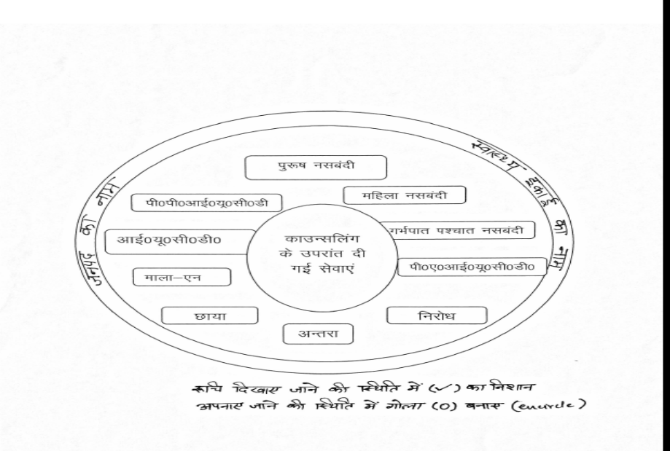
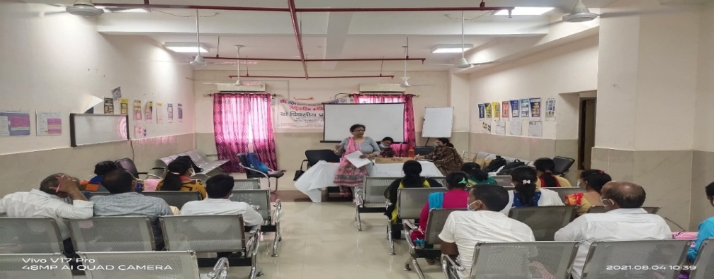
Quality in FP Service Delivery
As we have seen and increase in spacing services focus is on strengthening quality
Counselling stamp have been developed for counsellors to offer basket of choice to the client.
Verification of beneficiaries through 104 call centre being initiated
Integrated trainings for RMNCH+A and AFHC Counsellors
Integration of PPFP in Mantra App
Regular Sharing of HMIS Dashboard with the Divisions and Districts for informed decision making.
Initial emphasis is on strengthening FP and CAC services in FRU and then moving to Non FRU for strengthened FP and CAC service delivery.

Slide 10


Reaching to Newly Wed’s
Shagun" kit
To reach newly wed with this kit having; Vanity items, Family planning commodity ( Condoms, Oral Contraceptive pill, Pregnancy Kit & Emergency contraceptive pill pack) , Information material related to commodity , Marriage registration form and letter addressed to couple with the name of Health Minister
ASHA has to provide this kit to every newly wed in her community
Shagun Kits are also distributed during Khushaal Pariwar Diwas, Samoohik Vivah also by elective representatives
Shagun kit
Achievement in all Districts
Activities | Targets for Year 2022-23 | Achievements upto Sept 22
Installation of Condom Boxes | 26430 | 17010
Saas Bahu Sammelan | 160706 | 53538
Distribution of Nayi Pahel Kit | 709528 | 90124

Slide 11
Recent Innovations

Slide 12
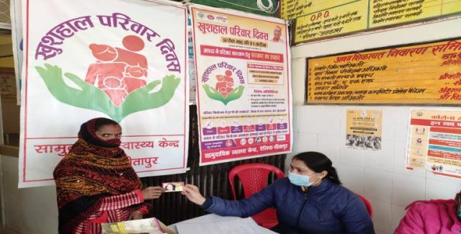
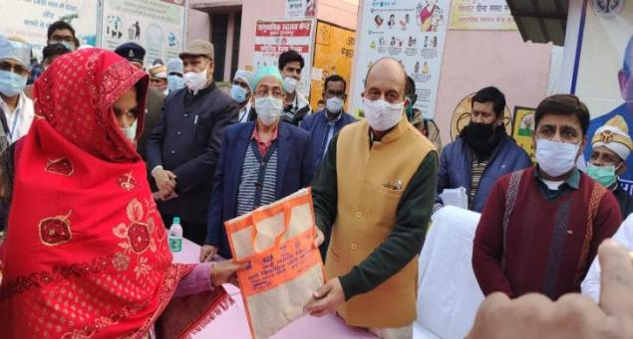
Khushaal Parivar Diwas
To bring the boast to the Family planning program, considering Covid-19 pandemic, to address various obstacles eg. engagement of human resource in Covid management, field activities and data related activities and interruption of FP commodities supply, state has initiated Khushal Parivar Divaw on 21st of every month as campaign since November 2020.
Three target groups have identifies which are as follows –
  1- Women who have been delivered having High Risk Pregnancy Women(HRP) in last one year.
  2- Newly married Couple in last one year.
  3- Eligible Couples having 3 or more children.
Community activities conducted by frontline worker with engagement and counselling by ASHA, identification and registration.
Assured service delivery to clients who have counselled at sites and linkages through public and private health facilities accredited and mapped under Hausla Sanjhdari
Ensuring commodities and service providers
Distribution of Shagun kits with FP counselling to newly weds
Interdepartmental convergence meeting under chairmanship of DM
Involvement and inauguration by MLA/Local bodies, Mahila samiti Adhyaksh and other key representatives for wider coverage and involvement.

Slide 13
Khushaal Parivar Diwas-Achievements
Year wise Achievements of Khushhal Pariwar Diwas Beneficiaries
Methods | Particular | FY 2020-21 | FY 2021-22 | FY 2022-23 |  |  |  |  |  | FY 2022-23 | Total (All Year)
 |  | Total (Nov. to March) | Total (June to March.) | Apr-22 | May-22 | Jun-22 | Jul-22 | Aug-22 | Sep-22 | Total (April to Sept.)
NSV | Beneficiaries | 499 | 612 | 30 | 53 | 28 | 61 | 37 | 96 | 305 | 1416
FST | Beneficiaries | 14163 | 16809 | 494 | 426 | 404 | 439 | 846 | 924 | 3533 | 34505
Mala N | Beneficiaries | 247189 | 453113 | 41768 | 44410 | 53641 | 45917 | 63605 | 80796 | 330137 | 1030439
Chayya | Beneficiaries | 173909 | 378850 | 40179 | 35743 | 36278 | 35589 | 54609 | 71446 | 273844 | 826603
Antara | Beneficiaries | 50842 | 86851 | 8655 | 6353 | 7852 | 6844 | 10234 | 13555 | 53493 | 191186
IUCD | Beneficiaries | 35851 | 58376 | 6566 | 4726 | 4921 | 5084 | 5617 | 6052 | 32966 | 127193
PPIUCD | Beneficiaries | 23454 | 30758 | 2806 | 2684 | 2588 | 2697 | 3476 | 3490 | 17741 | 71953
Condom | Piece Distributed | 1689495 | 3473389 | 347795 | 345679 | 354481 | 394860 | 478770 | 570699 | 2492284 | 7655168
Shagun Kit | Beneficiaries | 35651 | 31260 | 3416 | 2686 | 4192 | 2336 | 3764 | 3610 | 20004 | 86915

Slide 14
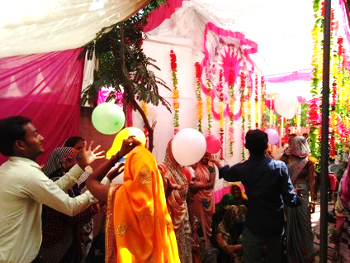
Saas Beta Bahu Sammelan
Saas-Bahu Sammelan is being organized through ASHAs at the sub-centre level since 2017-18 in Mission Parivar Vikas Districts. Purpose is to enhance communication between the mother-in-law and the daughter-in-law on the basis of their mutual experiences, so as to change the perceptions, behavior and beliefs pertaining to reproductive health for good.
It has often been seen that the consent of men is paramount in almost all the decisions in the family, so the felt need was to engage son in the Saas-Bahu Sammelan ensuring male participation.
82% SBBS held in 2021-22 against physical target

Slide 15
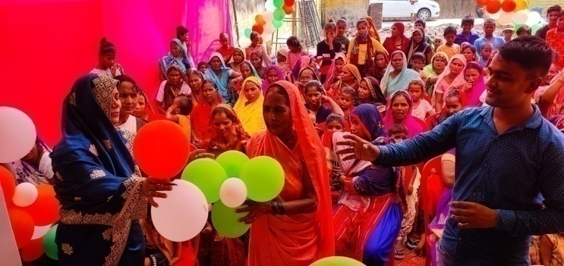
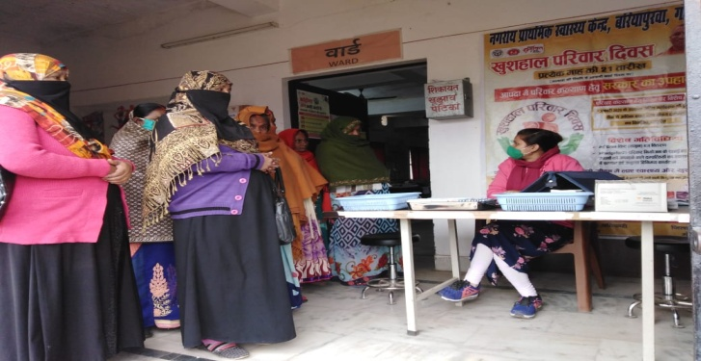
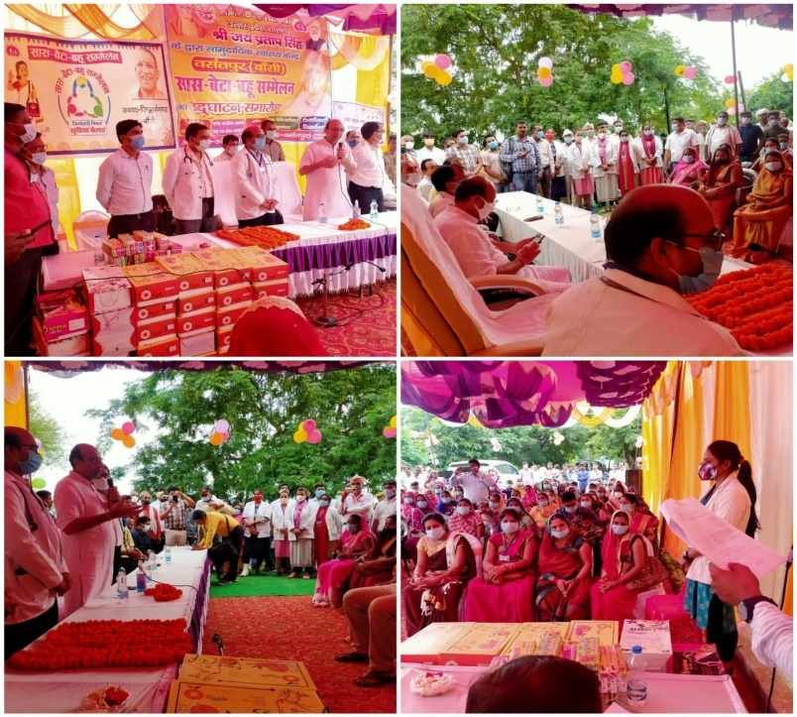
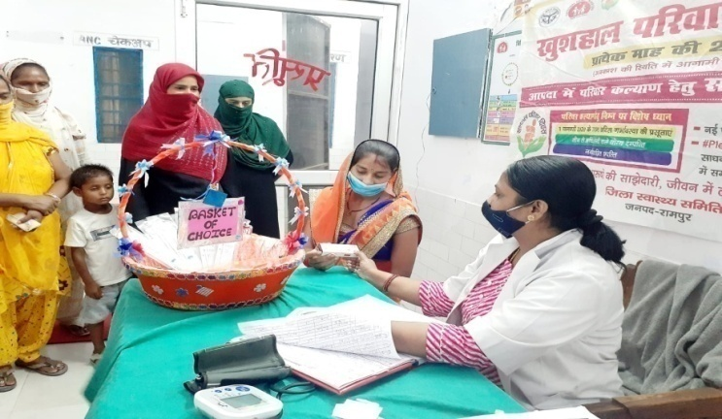
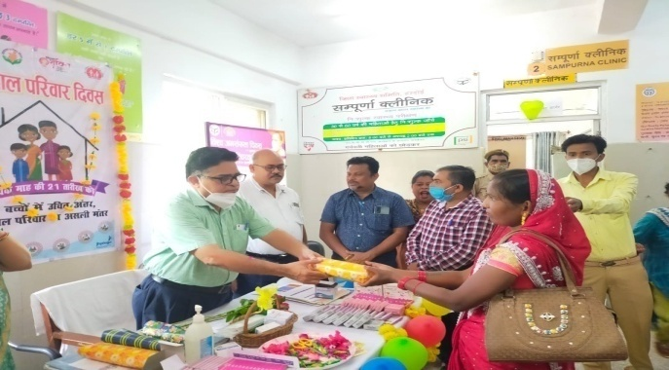
Saas Beta Bahu Sammellan
Khushaal Parivar Diwas

Slide 16
Male Participation Initiative
Based on the findings of the Male Participation Study; an initiative has been strategized to engage men in family planning for increased uptake of FP services.
Initiative objectives:
To increase the awareness in male about various family planning methods
To create awareness about the role of Male in increase uptake of family planning services
Strategy:
Male participation sammelan will be organized at sub centres and ASHA will mobilized cohort (Newly married couple & Men having family size 3 and more children).
Small groups will be formed and information about Family planning will be provided either through TV/Projector/Computer as per the availability in the facility.
Identified Male influencers will be oriented about Family planning, counselling and will equipped with standardized tool kit to facilitate in initiating dialogue
140 trainer have been trained in 18 districts. 273 Mr. Smart sammellon held at Block level in which 10675 Males were participated. During World Population Day fortnight total 59 NSV motivated by the team.
Target Group:
Newly married couple | Men having family size 3 and more children | DWH & CHC having high delivery load | Degree college

Slide 17
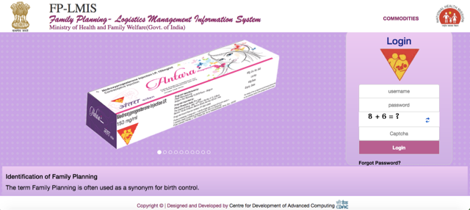

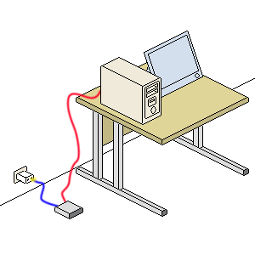
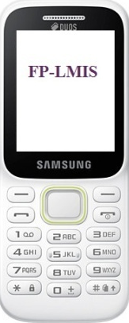
Family Planning Logistic Management Information System
A Web, Mobile and SMS based application that deals with demand forecasting, procurement, inventory management and monitoring of Family Planning Commodities from National Level to ASHA Level
Key features:
Instant access to stock information at all levels
Auto forecasting of contraceptives
SMS alerts
Auto generated reports
Facility-wise up to ASHA level functionality ( regular monthly indent issue and acknowledgement) review at GOI level.
Mobile based
Web portal based

Slide 18
FPLMIS Functionality Status: Uttar Pradesh
Facility Type | Total Facilities | Status as on 28 Oct, 2022 |  | Status as on 28 Oct, 2022
 |  | Indenting | % Indenting | Issuing | % Issuing
District Facilities | 144 | 134 | 93 | 103 | 71
CHC | 981 | 927 | 94 | 774 | 78
Medical College | 19 | 19 | 100 | 3 | 15
PHC | 2713 | 2199 | 81 | 1212 | 45
UPHC | 594 | 585 | 98 | 499 | 84
SC | 19156 | 14294 | 74 | 8355 | 43
Asha | 150209 | 99907 | 66 | 34567 | 23
Total | 173816 | 118065 | 67 | 45513 | 26

Slide 19
Clinical Family Planning Trainings
SN | Training Name (TOT) | Target FY 2022-23 | Completed till Oct 22 | Remarks
1 | Comprehensive Abortion Care TOT | 2 Batch, 20 MOs |  | Planned (2nd – 5th November 2022)
2 | MMA TOT | 2 Batches, 16 MOs | 2 Batches, 30 MOs | Completed
3 | Post Partum Mnilap with normal delivery- TOT | 2 Batch, 16 MOs | 2 Batch, 20 MOs | Completed
4 | Lap TOT | 1 Batch, 8 MOs | 1 Batch, 10 MOs | Completed
5 | Comprehensive IUCD & PPIUCD TOT | 1 Batch, 8 MOs
6 | Minilap TOT | 1 Batch, 4 MOs
SN | Training Name (Induction Training) | Target FY 2022-23 | Completed till Oct 22
1 | Undergraduate -MBBS Final Year | 43 Batches, 1505 Students | 42 batches, 1451 Students | last batch planned in nov22
2 | New contraceptive- 2 days online Training CHOs/ANMs | 60 Batches , 1200 CHOs/ANMs | 42 Batches , 1231 CHOs/ANMs
3 | LAP Induction | 36 Batches, 144MOs & 120 SNs | 5 Batches, 18 Mos & 14 SNs | ongoing
4 | CAC & LAP- Combine (SR & JR-3) | 160 SR/JR (17 Batches) | 3 Batches, 15 SR/JR | ongoing
5 | Comp. IUCD & PPIUCD (SR & JR-1,2,3) | 205 SR/JR (21 Batches) | 9 Batches, 42 SR/JR | ongoing
6 | Post Partum Minilap with normal delivery- SR | 25 SR (5 batches) |  | ongoing
7 | Postpartum Minilap with normal delivery | 26 Batches, 104 Mos | 5 Batch, 21 Mos
8 | Minilap Induction | 10 batches, 40 MOs | 1 Batch, 4 Mos
9 | Comp IUCD & PPIUCD Training Mos/Ayush | 41 Batches, 410 Mos
10 | Comp IUCD & PPIUCD Training CHOs/ANM/SN | 50 Batches, 500 CHOs/ANM/SN
11 | Comprehensive Abortion Care MBBS/Gyne | 82 Batches, 271 Mos | 10 batches, 40 MOs | ongoing
12 | MMA specific trainings -03 days | 30 batches, 300 MOs |  | Planned

Slide 20
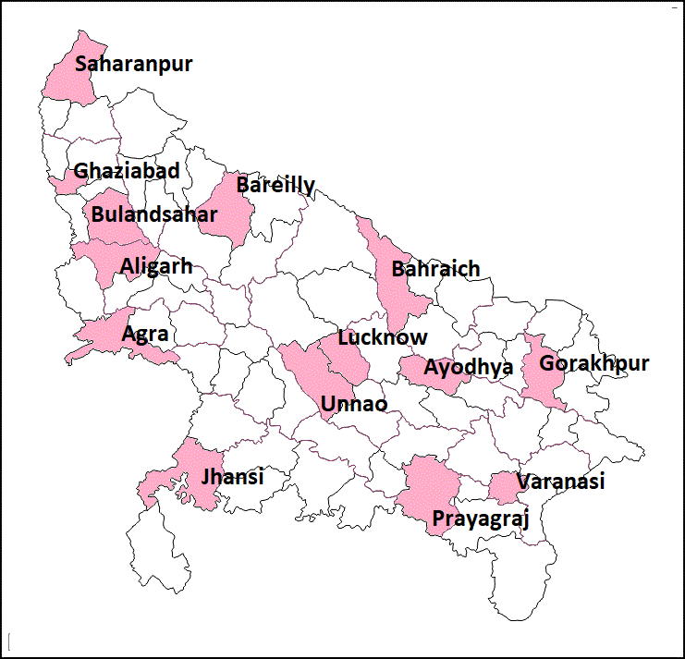
Comprehensive Abortion Care
1089 doctors were trained through 12 Training centers from 75 districts till date since FY 2015-16 to Oct’ 2022.
Total 271 doctors are to be trained in 82 batches at 14 training centres, out of which 177 doctors in 57 batches are of MBBS doctors to be trained and 64 doctors in 16 batches are of OBGYN, as per PIP 2022-23.
43,028 women were able to get safe abortion services in nearby government facility since April’22 to Sep ‘22.
Dissemination of MTP Act Amendment 2021 was conducted through Regional/Divisional and District level meetings in the state.
In FY 2022-23, 30 batches of MMA specific trainings are planned in Uttar Pradesh. MMA specific ToT has been completed.
14 Training Centres
74 Intervention Districts
1089 Provider trained
New IEC material as per MTP Act Amendment 2021, has been launched on World Population Day 2022.

Slide 21
CAC Status Updates
Facility | Total No. of Facilities | No. of women Served in FY 2021-22 | No. of women Served in FY 2022-23 (April-September)
Medical Colleges | 18 | 3262 | 2726
District Women Hospital including Women and children Hospitals | 99 | 31643 | 28988
Sub Divisional Hospitals | - | - | -
CHC’s (FRUs) & Other sub District Level Hospitals | 318 | 15056 | 4906
24 X 7 PHCs, Non FRU CHCs | 544 | 5924 | 1560
Other PHCs | 3541 | 767 | 431
Approved NGO & Private Clinics & Hospitals | 965 | 8020 | 4417
Total | 5485 | 64,672 | 43,028

Slide 22
PC&PNDT Act : State progress up to September 2022
No. of cases filed in Court due to violation of PCPNDT Act- 316
No. of convictions held till date- 26
No of Center Registered- 6966
No of Machine Sealed-206 (Fixed) and 155 (Portable Machine)
Centers whose registration was cancelled/suspended-530
Mukhabir Yojna started from July 01, 2017, till now 13 decoy operations have been held.
Sex Ratio At Birth As Per HMIS Data
State/District | 19-20 | 20-21 | 21-22
State | 928 | 929 | 933
Maharajganj | 928 | 941 | 934
Chitrakoot | 939 | 927 | 947
Improvement in Sex Ratio at Birth
As per National Family Health Survey -5
State/Country | NFHS-4 (15-16) | NFHS (19-21)
INDIA | 919 | 929
UP | 903 | 941

Slide 23
Improvement in Sex Ratio at Birth
As per Health Management Information System
Year wise Inspections

Slide 24
Maternal Health

Slide 25
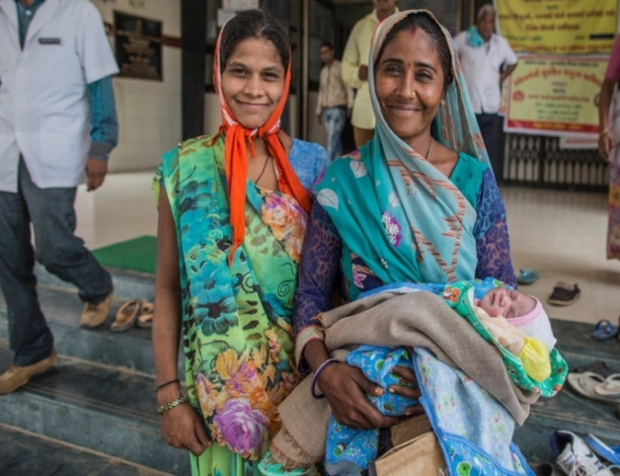

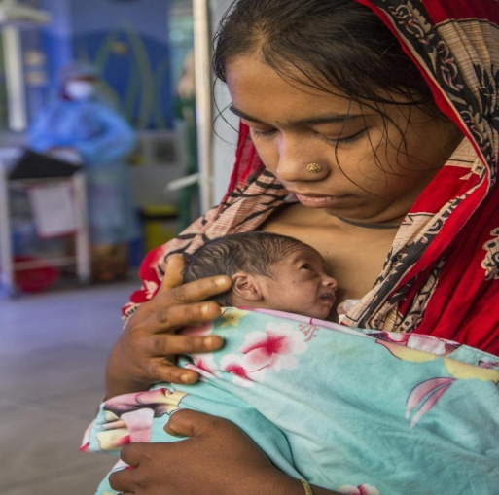
MATERNAL HEALTH
MATERNAL HEALTH
JSY
JSSK
PMSMA
MDSR
SUMAN
FRU Strengthening
MIDWIFERY

Slide 26
JSY Progress over the years
(up to Sep2022)
Source: State Report

Slide 27
JSSK Achievement as per HMIS report
 | FY-2019-20 | FY-2020-21 | FY-2021-22 | FY- 2022-23 (up to Sep 22)
Free Drugs | 27,40,063 | 38,42,866 | 39,41,553 | 19,91,305
Free Diagnostics | 27,65,497 | 36,82,555 | 38,26,146 | 19,77,881
Free Diet | 13,23,339 | 17,23,616 | 17,40,198 | 7,60,640

Slide 28
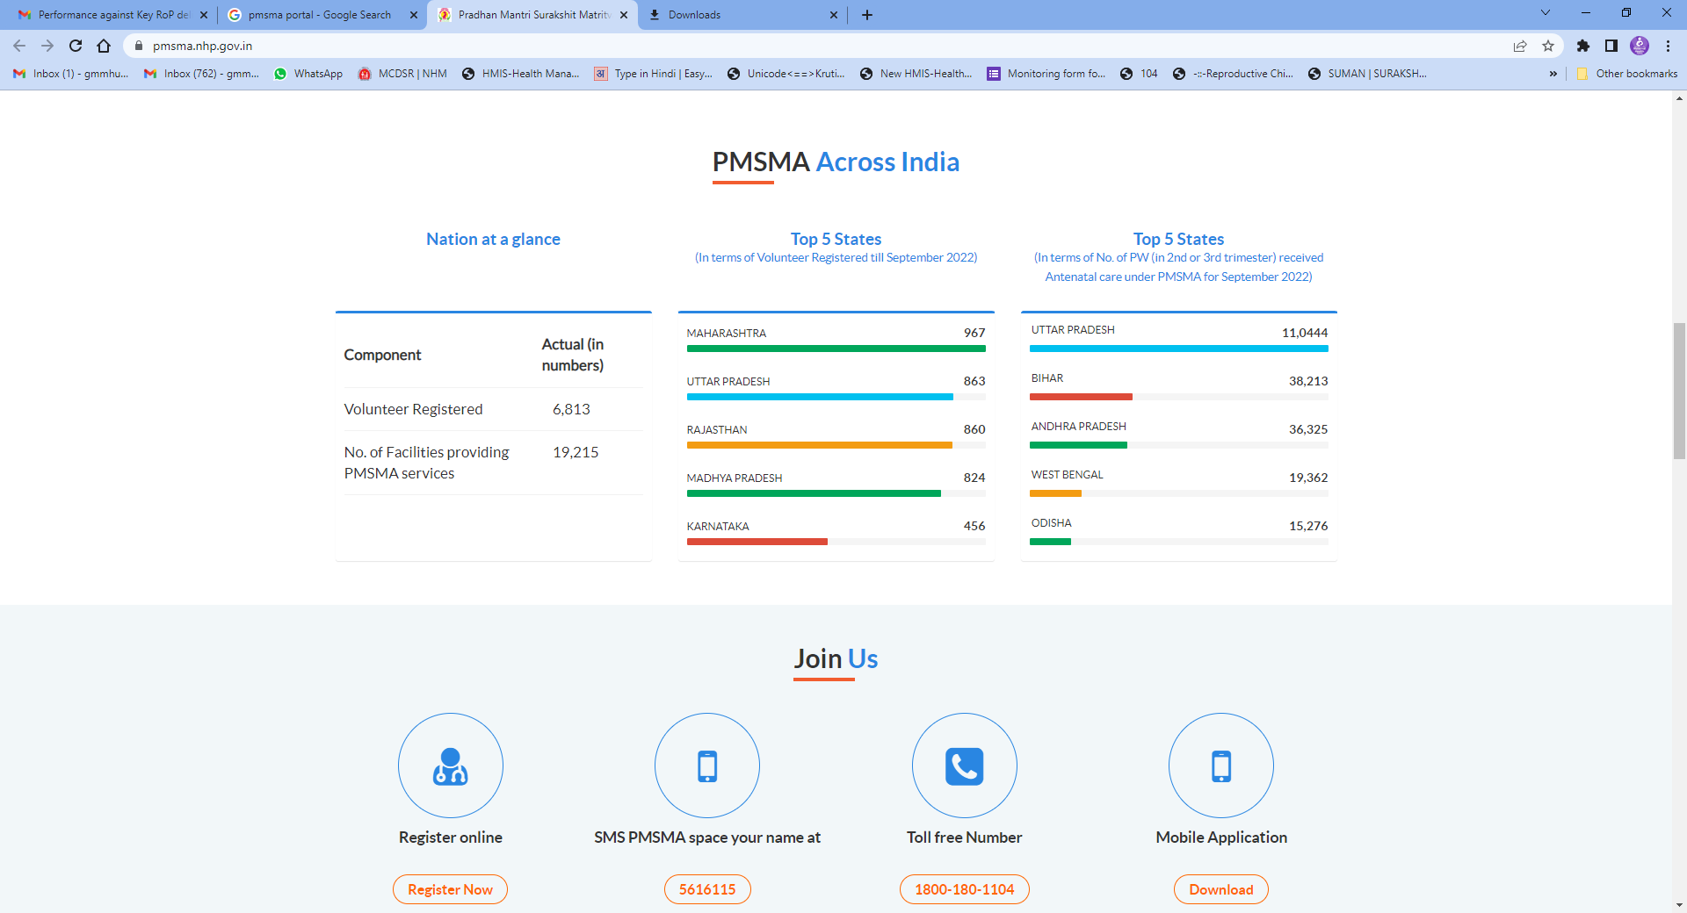
Pradhan Mantri Surakshit Matritwa Abhiyan (PMSMA)
1615 Govt Health Facilities providing services on PMSMA day on 9th of every month.
417 Govt Health Facilities (FRUs) providing services on PMSMA Plus day on 24th of every month .
901 Pvt. doctors registered to volunteer their services.
Snacks distributed on PMSMA day to all pregnant women visiting facilities.
8,09,730 PWs availed ANC services and 95,952 HRPs identified on PMSMA day up to Sep 2022

Slide 29
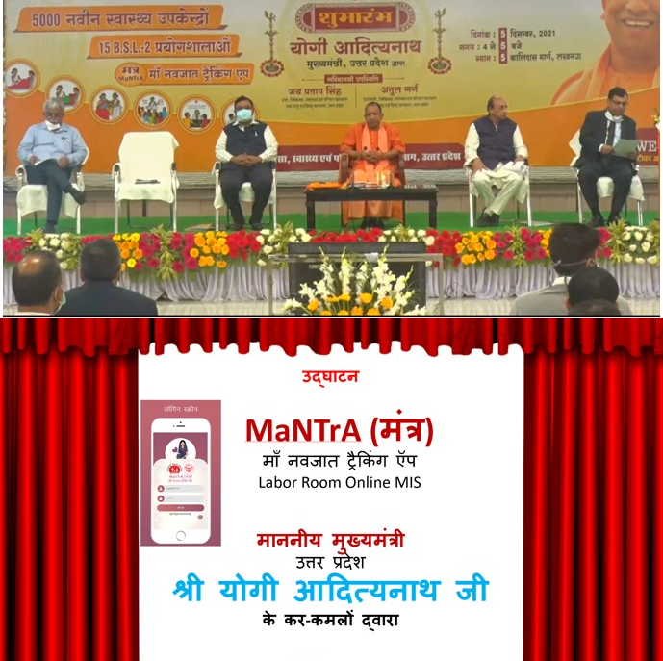
MaNTrA- Maa Navjaat Tracking App
Labour Room Online MIS
Uttar Pradesh
To capture online real time data of deliveries and referrals from delivery points and gradually phasing out of physical delivery and referral out registers.
Identifying most common causes of HRPs identified
in Labour room and strengthening identification of
same in antenatal period
Tracking HIV and syphilis status and screening in
Labour room as required
Identifying most frequent maternal complications
and capacity building on management of the same
Utilization of ambulance 102/108 by community for
reaching the facility
Analyzing uptake of interval and limiting methods for
FP as per gravida status & focusing FP counselling
accordingly
Follow-up of LBW newborns in community
Monitoring C-Sections done in FRUs
Monitoring blood transfusions done in FRUs
Monitoring referrals by non FRUs.
Creation of CRS sub module under MaNTrA
Robson classification is also added which helps to group cases
with caesarean section in order to assess differences in outcome across regions and sites.

Slide 30
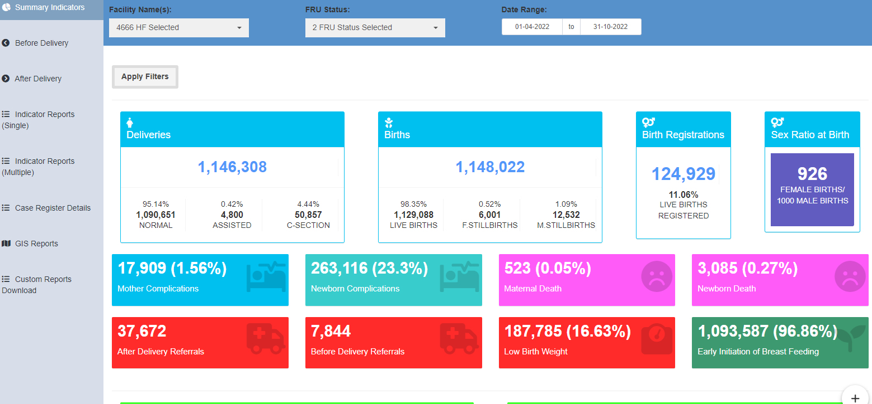
Screen Shot of MaNTrA dashboard

Slide 31
Other Activities
Buddy -Buddy Model- An initiative has been taken by the state for Rapid activation of FRUs through EmOC - LSAS trained doctors in which EmOC -LSAS trained Medical Officers are posted in the inactive CHC FRU of their choice after 6 months of Mentoring at the District hospital. Such LSAS-EmOC trained doctors are deputed at 118 FRUs to make them functional.
Midwifery Initiative- Meerut College of Nursing has been identified as NMTI. First Batch of Midwifery Educator training has been started at NMTI, Meerut from june 2022. Kanpur college of Nursing is being developed as SMTI. Two more nursing colleges are being identified for SMTI.
SUMAN program- 582 facilities have been notified in the state of Uttar Pradesh. District & Block level committees formed. IEC done in 30 facilities. In FY 2022-23, notification of additional 500 facilities is in process.
Maternal deaths- Rs. 1000/- incentive for the Primary Informant of community maternal death through 104.
LaQshya-
  At present 53 facilities are LaQshya certified. Assessment report of 07 Facilities having undergone National assessment awaited.
  Certification has been prioritized in 200 health facilities in FY 2021-22. State ToT of all 75 Districts completed. Internal assessment of all 200 facilities have been completed .
  Request for national assessment of 08 New facilities sent to GoI.
  60 facilities have been state assessed and are in process of sending request to GoI for national assessment.
Additional DPs- 300 HWC-PHCs have been upgraded to 24x7 delivery points.
6 Months Obstetric Ultrasound Training for Medical Officers.
15 Days Ultrasound Training for Specialist Doctors (Gynaecologist).
12 Days Training of Surgeons for C-Section.

Slide 32
Strengthening Of Blood Services

Slide 33
Status of Blood Banks in Uttar Pradesh
S.N. | Indicators | Units
1 | Total Districts | 75
2 | Total Blood Banks in the State ( Gov. & Private) | 428
3 | Districts Without Govt. Blood Banks | 04 *
4 | No. of Govt. Blood Banks in the State | 101 ( 76 DH + 24 MC+1 CHC)
5 | BCSUs in the Govt. Hospital | 50
7 | Blood Bank in Military Hospital | 08
8 | Divisional Blood Collection &Transportation Van | 18
9 | Total Haemophilia Treatment Centres | 26
10 | Total Thalassemia Treatment Centres | 16
11 | Total Approved BSUs in State | 106
*Blood Bank establishment in District Hospital Amethi, Hapur, Sambhal & Shamli are under process.
S.N. | Indicator | Status FY 2021-22 (Govt.)
1 | Total Blood unit Collected | 405166
2 | Blood Unit Collected through Voluntary donation | 179989
3 | Voluntary % | 44
4 | No. of Camps organized | 2248
5 | Collection through camps | 61858
7 | Component Preparation through BCSU | 226147
8 | Component % | 81
9 | Total Camp Through BCTV ( Blood Collection & Transportation Van) | 687
10 | Collection Through BCTV | 25207

Slide 34
Blood Collection & Component preparation Trend

Slide 35
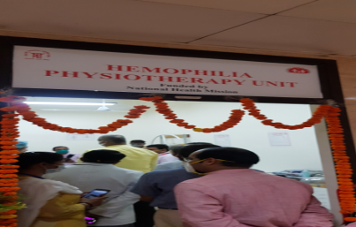
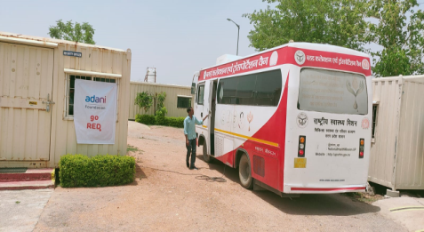
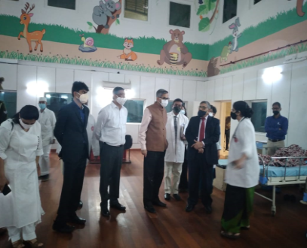
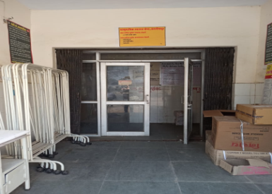
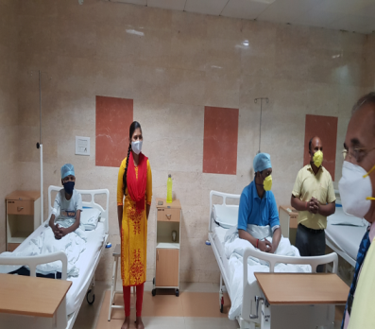
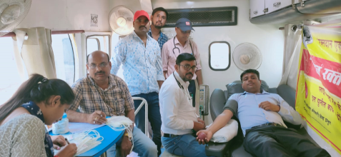
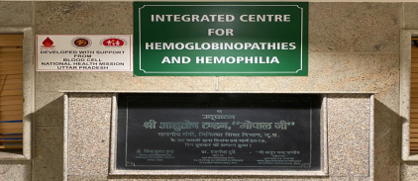
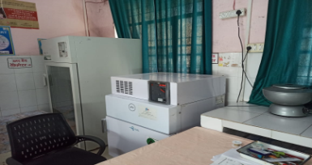
Blood Cell
Key Achievements
195 Blood Storage Centers (BSCs) are being established. Out of total 113 BSUs get approval from FDA for Operationalization.
Free diagnosis and treatment are being provided to about 1700 Thalassemics & about 4600 Hemophilia patients registered under government health facilities
Up gradation of 43 Blood Center in Blood Component Separation Units (BCSUs) and establishment of 04 new BCSUs are under process to enable govt.
blood component facility in all districts of state.
Free Blood & Blood Components availability to all patients requiring blood admitted in govt. facilities.
Hemophilia Physiotherapy Centre
Hemophilia Treatment Centre
Blood Collection Transportation Van
ICHH
Blood Storage Unit

Slide 36
Child Health

Slide 37
Sick Newborn Care Unit
2007-08
First SNCU at Lalitpur
2014-15
27 SNCUs
2016-17
49 SNCUs
2019-20
80 SNCUs
2021-22
89 SNCUs
91 functional SNCUs across 73 Districts.
03 SNCUs are under establishment –Kasganj, Amethi, DDU Hospital Aligarh
New SNCUs/NICUs approved in 22-23 -MC Budaun, MC Basti, MC Ayodhya, MC Azamgarh, MC Banda, RSM Combined Hospital Lucknow & DWH Hapur
35 Upgraded NBSUs proposed at FRU-CHCs in PIP 22-23.

Slide 38
Trends of Bed Occupancy Rate
Efforts done by State
Regular review meetings with SNCUs based on MIS online report
Sensitization visits of MOICs, BCPM, ASHA Sanginis in SNCUs with low BOR
Bed expansion in SNCUs with high BOR
Mentoring visits in SNCUs –Mentoring being done.
Trends of Out born Admissions
Source: SNCU Online MIS

Slide 39
NBSU
Approved | 436
Functional NBSUs | 184
Capacity Building of NBSU Staffs | 33 batches of NBSU training were planned , out of which 14 batches have been completed.
Training | New initiative of observership training of NBSU staff for 6 days in SNCUs approved in PIP of FY 2022 - 24
Source: SNCU Online MIS

Slide 40
Innovation/ new practices for improving the FBNC in the State
Capacity Building of NBSU Staff
33 batches of 3 days NBSU training for staff nurses, MO/pediatrition were planned , out of which 14 batches have been completed.
Capacity building of Labour Room Staff through NSSK Training
10 batches of TOT followed by 495 District level trainings is planned.
FBNC Observership Training
SRC KGMU, Lucknow & IMS BHU, Varanasi
State has established 02 State Resource Centres at Dept of Neonatology & Paediatrics at BHU Varanasi & KGMU, Lucknow.
First batch of Observership Training conducted in KGMU, Lucknow
SNCU Mentoring Program
State has issued guidelines for SNCU Mentoring Visits through 02 State resource centres. SNCU Mentoring Visits is going on in districts.
Training continued in Kalawati Saran Hospital -07 batches of conducted in 22-23

Slide 41
SAANS(Social Awareness and Action to Neutralize pneumonia Successfully)
15 Batches of State training of trainers completed in 64 Districts (85%), where as 384 District level Participants were trained on SAANS (ACMO, pediatricians, medical officers, staff nurses)
Rollout of District level trainings - SAANS 14 districts completed one day training of Field level worker,1350 participants were trained and 480 participants were trained in two days training for medical officer and staff nurse
Letter has been issued to ALL CMOs regarding ASHAs orientation during monthly meeting and also being trained for “SAANS” along with HBYC training Programme.

Slide 42
CDR-Child Death Review
Guideline issued to include CDR in DHS agenda.
The District level committee’s letter was issued to all CMOs in 75 Districts
A letter was issued to all CMOs (75 districts) regarding the training of Block data operator training on MPCDSR software at District level
A Zoom meeting was held with GoI, NHM &UNICEF (UP) on issue and challenge in MPCDSR software
District Data managers (75 Districts) training conducted on MPCDSR Portal in reporting and recording at State level
Monthly CDR review meeting being conducted at Divisional level in 3 Division – Moradabad commissioner started the review of CDR programme, Additional director health Ayodha and Gonda division also review the CDR programme and District Jhansi and Banda CMO reviewed CDR portal entry

Slide 43
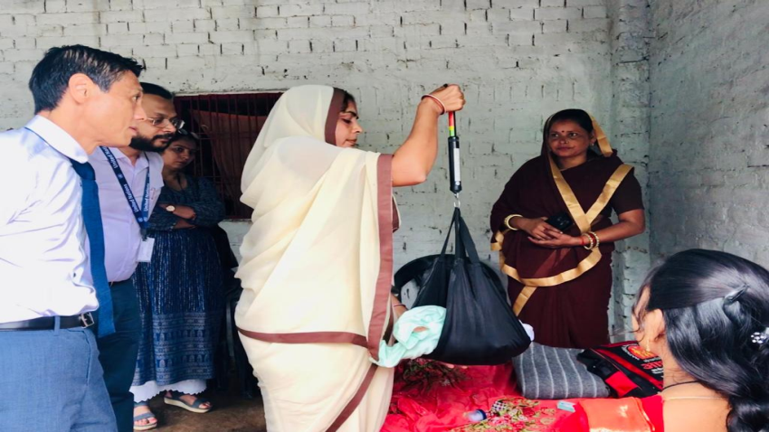
Home Based Newborn Care Programme
ASHA Module 6 & 7 training progress
N= 1,61,604
Urban HBNC, N= 7,837 (45 Districts)
Physical and Financial Progress
Weighing of newborn by ASHA during HBNC visit
1.40 lakh ASHAs are trained in HBNC and 15.56 lakh newborns were covered under HBNC by ASHAs from April 2022-Sept 2022
Source: MPR & FMR

Slide 44
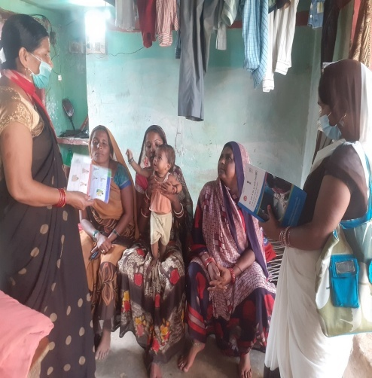
Home Based care for Young Child Programme
% ASHAs (round-3rd trained) vs FLWs trained on HBYC
% ASHAs (out of trained) reporting HBYC visits
HBYC state ToT of 70 districts have been completed.
35 districts have completed districts ToT on HBYC.
In 11 additional districts have started training of FLWs in 2022 and 14897 FLWs are trained.
HBYC module and Job Aid has been printed by all the 75 districts.
Guidelines has been issued to remaining districts to conduct district ToT and training of FLWs.
Counselling by ASHA during HBYC visit
Source: HBYC government report- April-Sept 2022

Slide 45

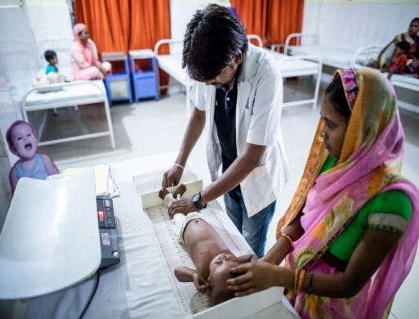
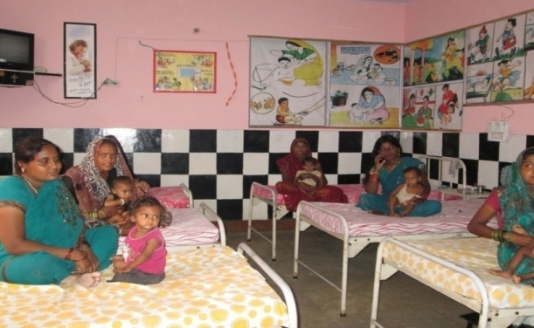
SAM program journey in Uttar Pradesh
Before 2020
77 NRCs operational in 71 districts to provide facility- based treatment
Sept. 2020
Poshan Maah 2020 - First guidelines on community-based treatment of SAM
Jan- March 2021
1st Wednesday of every month designated for SAM management (VHSND)
Technical committee constituted
State level program launched (3 March)
ICDS – growth monitoring devices procured
July 2021
ICDS SAMBHAV campaign – focus on SAM/MAM
Ekavach app for SAM enrollment rolled out

Slide 46
Rashtriya Kishor Swasthya Karyakram (RKSK)

Slide 47
Rashtriya Kishor Swasthya Karyakram (RKSK)
PROGRAM | TARGET BENEFICIARY | PLATFORM | Implemented In
AFHCs | Adolescents 10-19, Married, unmarried | DH, CHC ( 57Distt) | 25 HPDs (DH & CHCs) + 32 Non HPDs (DH)
Peer Education | 10-19 School going, Non school going, Married, Unmarried | Villages | 25 HPDs (RKSK Districts)
WIFS/NIPI | 5-10 year age group ( Pink IFA) | Primary School | 75 Districts
 | 10-19 year age group & Non school going Girls, Married-Unmarried (IFA Blue)4 | Govt. Secondary Schools & AWC
SHP | 10-19 year age group School going girls & boys | UPS & inter college | 23 Districts
Kishori Suraksha Yojna (KSY) | School going girls | Secondary Schools | 75 Districts by UP Govt.

Slide 48
RKSK Achievements up to September 2022
Sl. | Activity | Target | Achievement | Remarks
1. | Establishment of AFHS clinics | 398 | 348 (92 at Distt. )+ 256 at Block CHC(HPD) | 50 clinics NOT Established
2. | Peer Educators Selection -Existing in 25 HPDs +in 5 HPDs for scale up | 71481 | 66590 (93.16%) | 44514 (66.85%) Trained Remaining Selection in process
3. | Quarterly Adolescent Health Day (AHD) at SC level | 10268 | 1976 (19.23.%) | One round AHD celebrated at SC level
4. | Monthly AFC meeting | 20536 | 8383 (40.00%) | Meeting conducted at SC level
5. | National Deworming Day (NDD) | 941.30 Lakh | 704.12(74.80%) | NDD first round conducted in 75 districts (July 2022)
6. | Kishori Suraksha Yojana 23.89 Lakhs adolescent girls (No NHM funded | 310.97 Lakhs packet | 57.62 (18.63%) lakhs packet Sanitary Napkin distributed | Scheme implemented by State Govt fund.

Slide 49
AFHS Achievements (In Lakhs)
INDICATOR | September 2022 |  |  | September 2021
 | Male | Female | Total Beneficiary | Total Beneficiary
Total Clients registered | 2.13 | 2.50 | 4.63 | 2.12
Total no of clients who received clinical services | 0.97 | 1.35 | 2.31 | 1.12
Total no clients who received counseling services | 1.63 | 2.00 | 3.63 | 1.88
WIFS Achievements
INDICATOR | Total WIFS coverage till September 2022 (35.9 %) |  | Total WIFS coverage September 2021(12.2 %)
 | Target | Coverage ( As per HMIS) | Coverage ( As per HMIS)
10 to 19 year non School going girls –AWC (Blue tablets) ( in Lakhs) | 22.14 | 8.36/month (37.8 %) | 9.7 /month (43.8%)
10 to 19 year School going Adolescents (Blue tablets) in Lakhs) | 105.65 | 40.29 /month (38.1%) | 14.9 /month (14.1%)
5 to 10 year School going boys and girls (Pink tablets) in Lakhs) | 125.33 | 42.14 /month (33.6%) | 6.1/ month (4.9%)

Slide 50
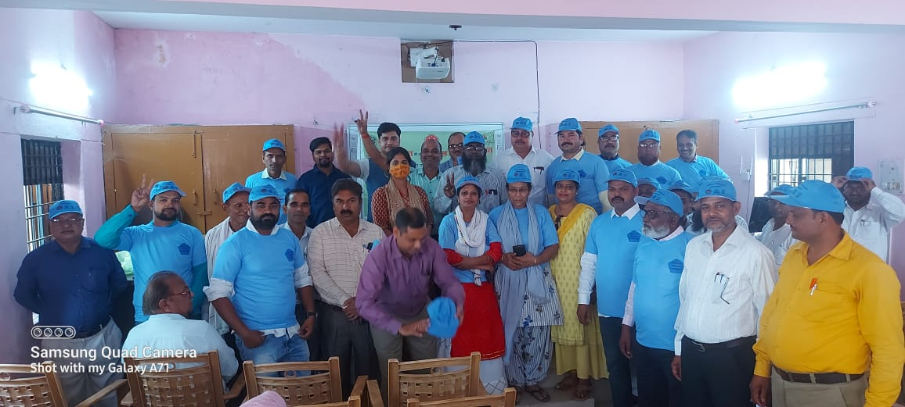
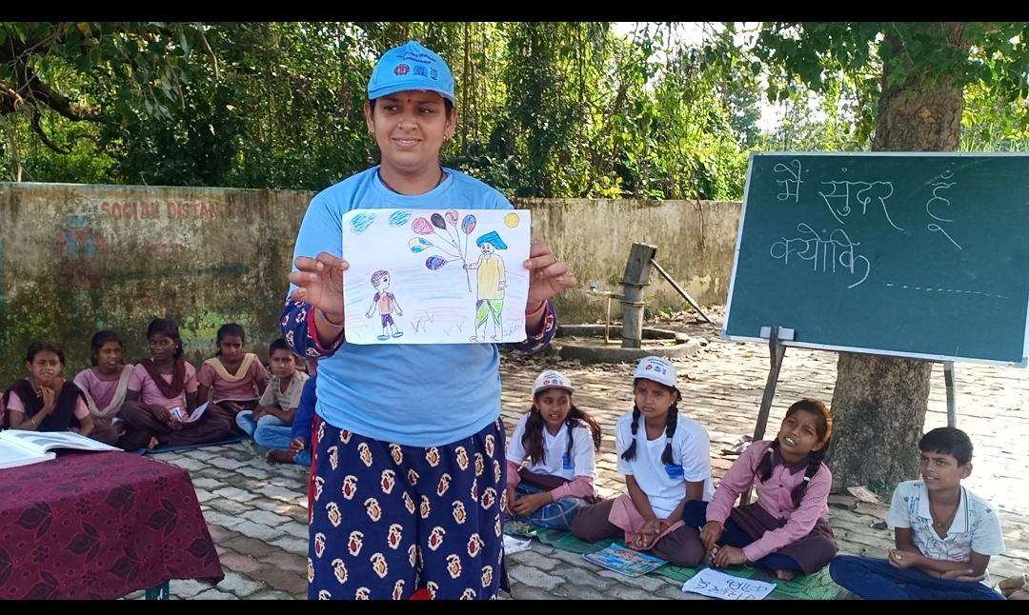
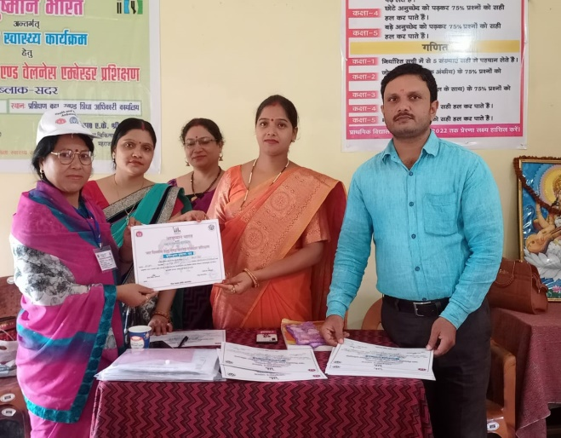
School Health Program achievement
Sl. | Activity | Target | Achievement till March 2022 | Achievement till Sept 2022
1 | Total no of district | 23 | 23 | 23
2. | Total no of School covered | 19537 | 19537 | 19537
3. | Total no of HWA selected | 39074 | 39074 | 39074
4. | Total no of principal oriented | 19537 | 14332 (73.36%) | 14332 (73.36%)
5 | Total no of HWA trained | 39074 | 19315 ( 49.43%) | 23465 (60.05%)

Slide 51
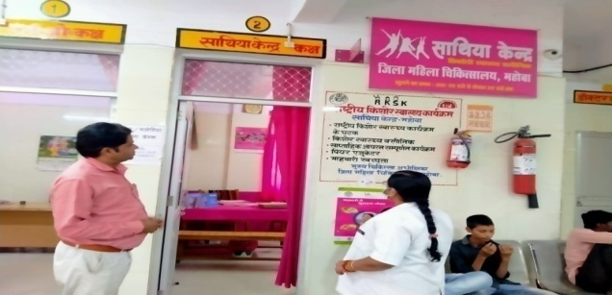
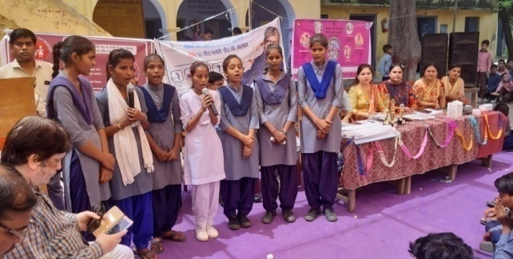
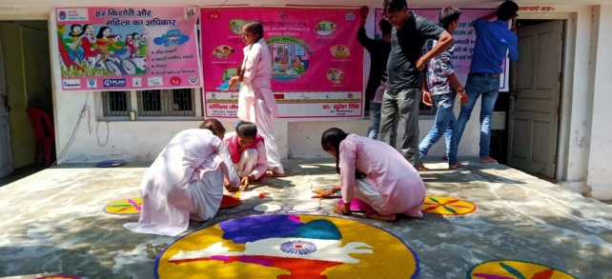
Programme initiative
Adolescent Friendly Health Clinics now branded as “Saathiya Kendra”
Monthly Theme based Outreach activity by the AH counselor
  June- Right age of Marriage
  July-Planned family
  Aug-Personal hygiene/Sanitation/ODF/Deworming
  September- Balanced diet
  October- Mental Health
  November-NCD
  December –Sexual and reproductive health
Organization of Kishor Swasthya Manch at 2 Inter colleges of each block to address Adolescent Health issues
NDD first round conducted in all 75 district Total 704.12(74.80%) lakh beneficiaries out of 941.30 lakh were covered during July 22 round.

Slide 52
Rashtriya Bal Swasthya Karyakram (RBSK)

Slide 53
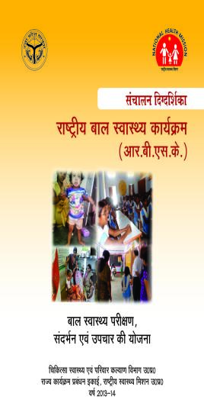
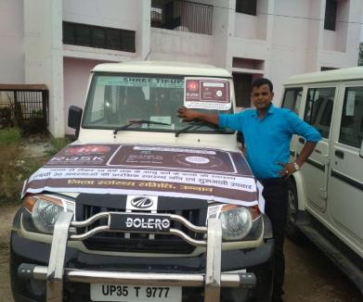


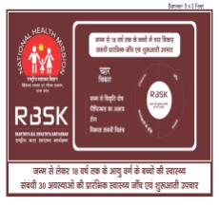

Rashtriya Bal Swasthya Karyakram (RBSK)

Slide 54
RBSK-Human Resource and Vehicle
(2022-23)
Details | Target | Achievement | In %
DEIC Manager at District level | 78 | 63 | 80.77%
Mobile Health Team at Block level | 1640 | 1591 | 97.01%
Medical Officer (AYUSH, MBBS & BDS) | 3280 | 2600 | 79.27%
Staff Nurse /ANM | 1640 | 1223 | 74.57%
Paramedical /Pharmacists | 1640 | 1359 | 82.87%
No. of Vehicle | 1640 | 1591 | 97.01%

Slide 55
School and AWC Screening | Target | 2022-23 (till Sep.2022)
School and AWC visited by MHT | 344011 | 1,72,713
Children screened by MHT | 32448347 | 103,52,153
% screening |  | 31.91 %
D.P Birth defect screening | Target | 2022-23 (till Sep.2022)
Birth defect screening at Delivery point | 1993788 | 8,73,415
Birth defect identification |  | 1112
% identification of birth defects out of screening |  | 0.13%
ASHA screening during HBNC | Target | 2022-23 (till Sep.2022)
Children screened by ASHA | 3367934 | 11,80,065
Birth defect identification |  | 493

Slide 56
Management of cases at identified units
A dedicated pediatric cardiac unit is functional at AMU Aligarh for CHD & RHD.
  In 2021-22- 237
  In 2022-23 (till Sep. 2022)- 155 children successfully managed.
DEIC centers- 6 centers functional at(AMU Aligarh, KGMU Lucknow, SSPH&PGTI GB Nagar, DCH Ghaziabad and DWH Aligarh & Moradabad)
  In 2021-22 - 4380
  In 2022-23(till Sep 2022)- 3807
Surgical intervention in medical colleges & identified institutions-
  In 2021-22- 522
  In 2022-23(till Sep 2022)- 347
Through NGO & Pvt. institutions
  Management of cleft lip/palate with the support of Smile train India
    2021-22-779
    In 2022-23(till Sep 2022)- 491
  Management of club foot with the support of Miracle feet India-
    2021-22- 1687
    In 2022-23(till Sep 2022)- 1119
  Cochlear Implant- 285 surgeries conducted from April 2021 till Sep 2022

Slide 57
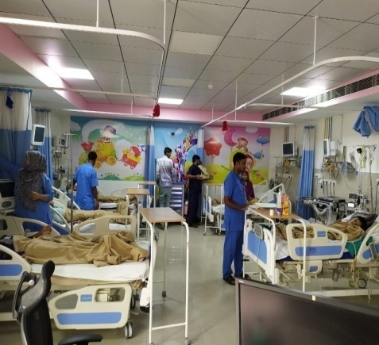
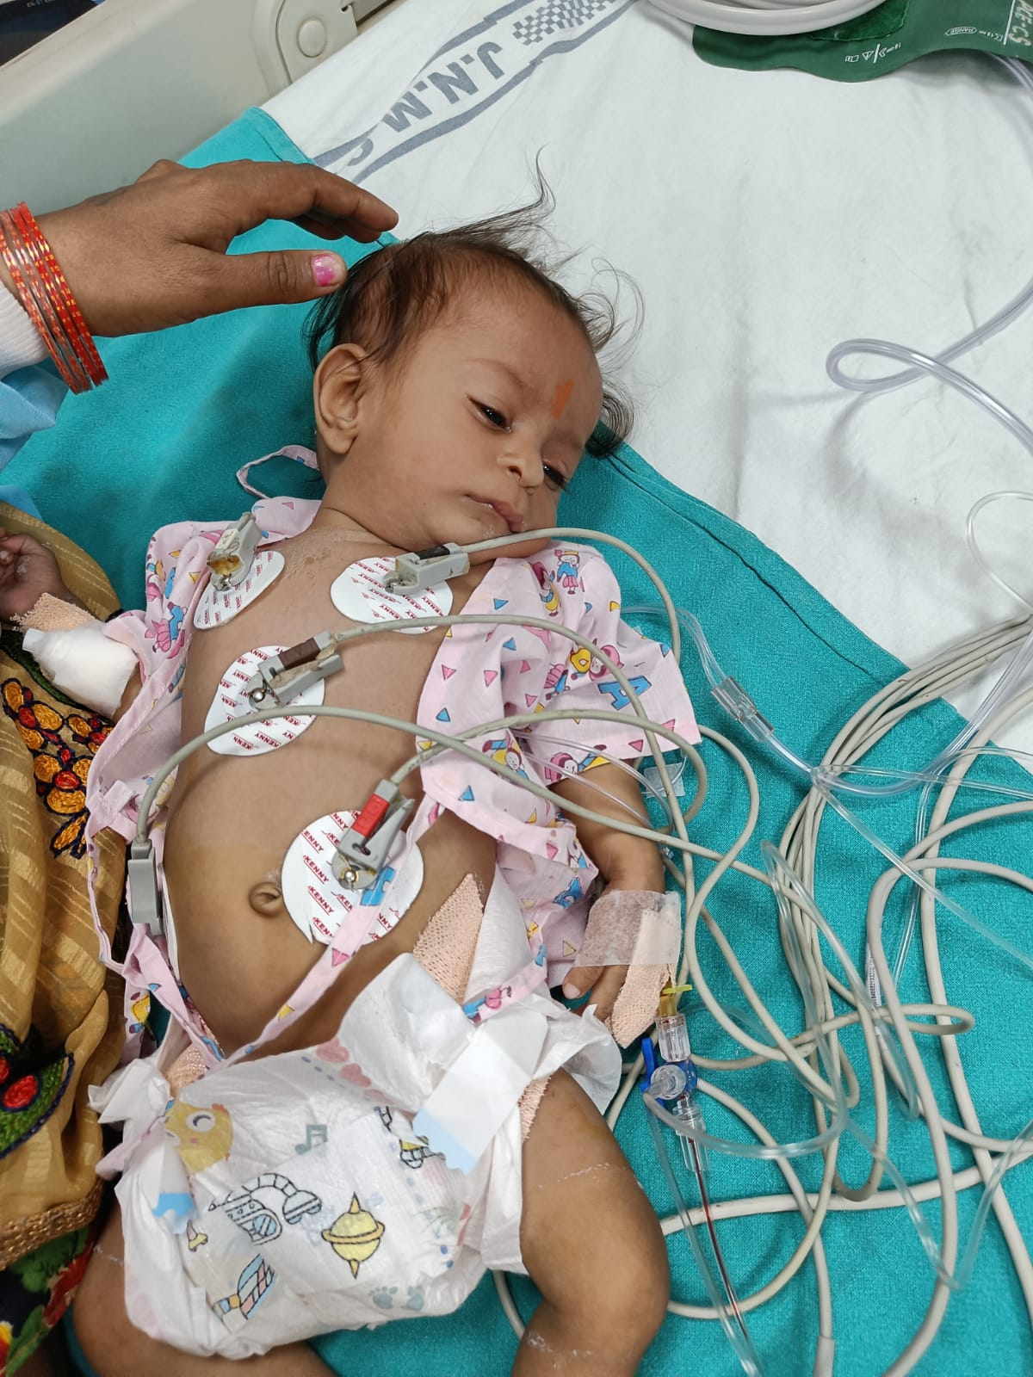
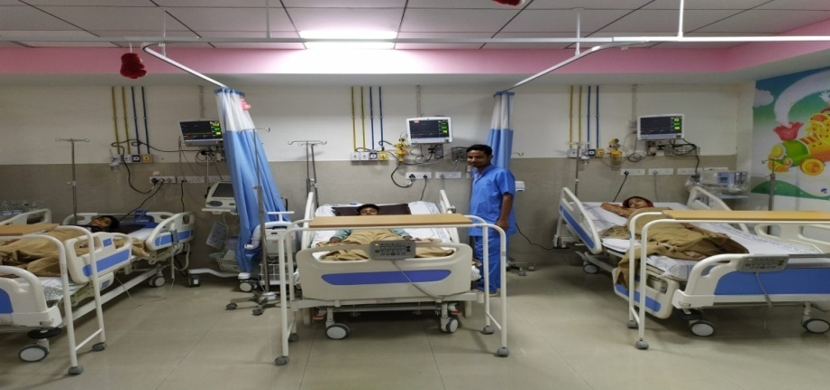
Pediatric Cardiac Unit (PCU)

Slide 58
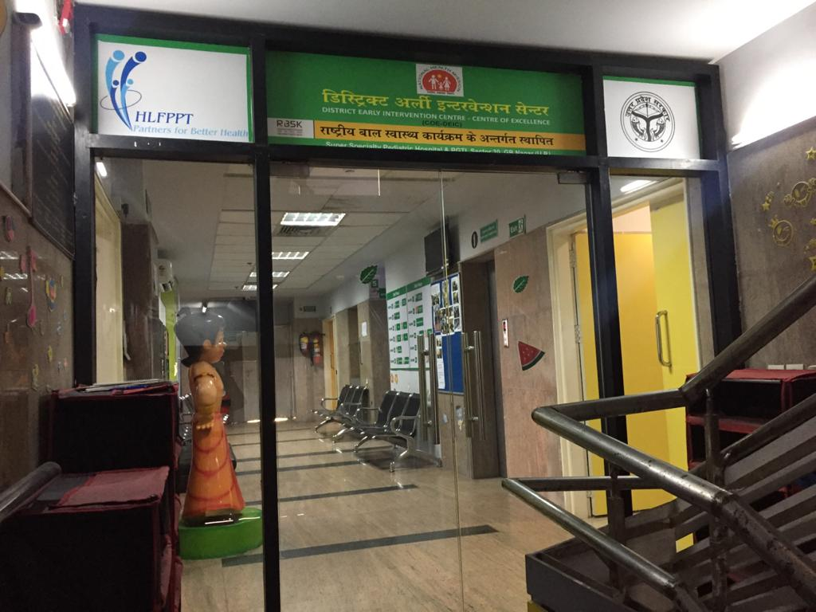
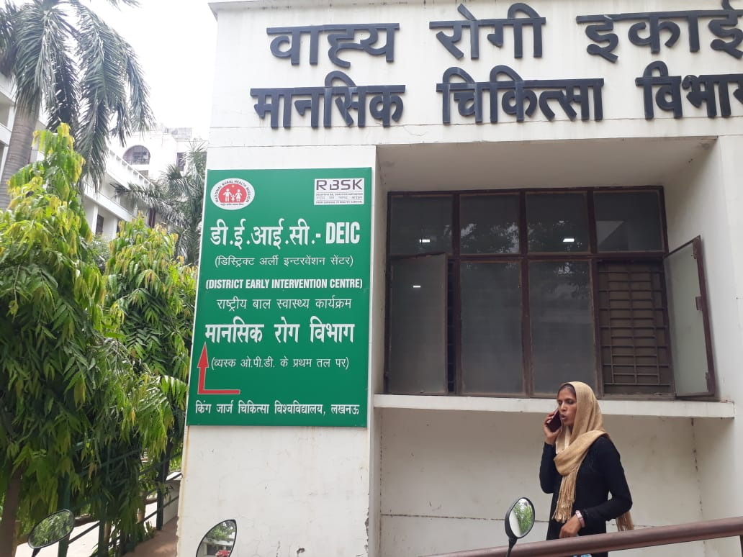
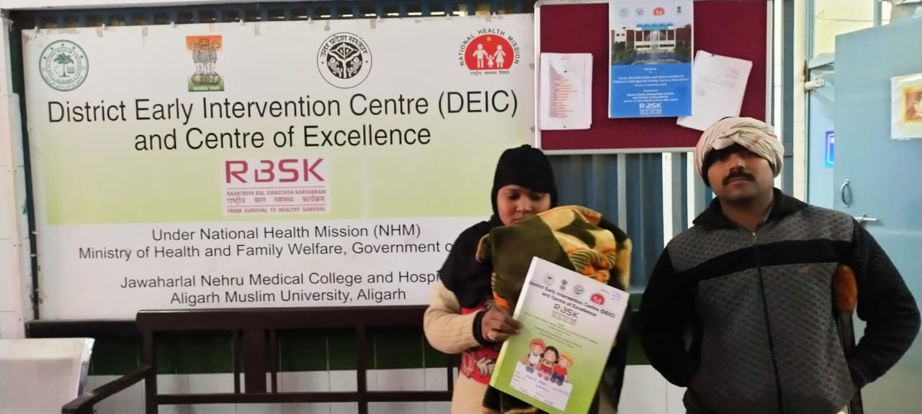
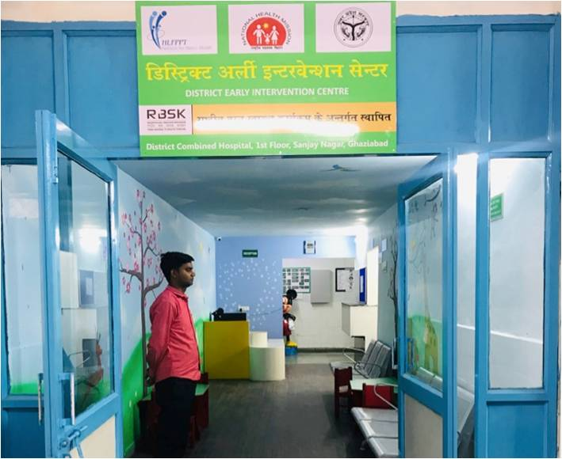
DEIC – District Early Intervention Centre under RBSK

Slide 59
Routine Immunization

Slide 60
Full Immunization Coverage (Reported FIC %)
Data Source- HMIS

Slide 61
Evaluated/Monitored Full Immunization coverage %
Monitoring data
MI started
IMI
IMI 2.0
IMI 3.0 & 4.0
*Source: RI monitoring data till Sep 22

Slide 62

Vitamin A Supplementation During Biannual BSPM Rounds
BSPM round not held due to non availability of Vitamin A Syrup

Slide 63
Immunization campaigns
Intensive Mission Indradhanush-4.0 (IMI)- Three rounds of Intensified Mission Indradhanush 4.0 (7th March, 4th April & 2nd May 2022) were successfully conducted in all 75 districts of Uttar Pradesh. After completion of three rounds total 3682512 (127.19%) children & 1031352 (129.26%) PW were vaccinated.
  Pulse Polio- Pulse polio(SNID) were conducted in 50 selected district of state. In this campaign total 221 Crore children vaccinated.
  Special Immunization Campaign- Special Immunization Drive has been conducted in 28 identified high priority districts and districts with outbreaks of diphtheria & measles from September 07, 2022 to October 15, 2022 during 1st phase. The second phase of the campaign will be conducted till 19th November, 2022 and the third phase till 20th December, 2022.
  Similar toto 28 high priority districts Immunization Drive is also being conducted in 10 poor performing districts with lowest full immunization coverage in Routine Immunization from 28 September 2022 to 29 October 2022.
eKavach Application- RI module of e-Kavach application is being utilised to enroll the due/left out beneficiaries and capture their vaccination for IMI 4.0, Special Immunization Drive and School Based Diphtheria Containing Antigens Drive.

Slide 64
Routine Immunization Trainings
Data Handlers Training
One Day training to be organized at District Level
Training Will be Facilitated by DIO/DPM/Partners/ M&E
Cold Chain Handlers Training
Two days Training to be organized at District Level
Training Will be Facilitated by DIO/Partners
Health Worker Training
Two days Training to be organized at District Level
Training Will be Facilitated by DIO/Trainers trained in State Level TOT/Partners
Medical Officer Training
Three days Training to be organized at RFPTC.
Training will be facilitated by Master Trainers trained at State
All data handlers of District and Block level to be trained
All CCH at SVS/DiVS/District/Block level to be trained at respected district .

Slide 65
RI-Training Plan-2022-23
S. No | Particulars | Cadres to be trained | Physical Target for Training in FY 2022-23 | No of days of training | Training at State/District level? | No of Batches | Remark
1 | Cold chain handlers training | Cold Chain Handlers | 94 | 2 | District | 94 | To be completed in Nov, 2022
2 | Data Handlers training | Computer Operator | 75 Districts | 1 | District | 75 | To be completed in Nov, 2022
3 | Health Worker (ANM) training | ANM/Health worker | 901 | 2 | District | 901 | To be completed in from Dec, 2022 to Jan 2023
4 | Medical Officers training | MO | 50 | 3 | RFPTC | 50 | To be completed in from Dec, 2022 to Jan 2023

Slide 66
Other Routine Immunization updates
MR surveillance transitioned to fever and rash surveillance in 2021-22.
Td vaccine rolled out in all 75 Districts
PCV vaccine rolled out in all 75 Districts
Social and Behavior Change Communication Strategy For Improving Routine Immunization in Uttar Pradesh and Communication planning for Routine Immunization

Slide 67
COVID-19 Vaccination till 27 October, 2022
16 January 2021 to 27 October 2022
 | Estimated Population | First Dose Coverage | % First Dose | Second Dose Coverage | % Second Dose | Precaution Dose | Total Doses Administered
HCW * | 1,009,876 | 985,549 | 97.6% | 994,077 | 100.9% | 902,563 | 2,882,189
FLW * | 1,043,604 | 1,045,618 | 100.2% | 1,076,284 | 102.9% | 1,504,398 | 3,626,300
Citizens 18 - 44 yrs | 99,733,447 | 102,592,316 | 102.9% | 96,732,189 | 97.0% | 24,966,580 | 224,291,085
Citizens 45 - 59 yrs | 28,938,442 | 31,330,740 | 108.3% | 30,881,162 | 106.7% | 10,354,670 | 72,566,572
Citizens 60+ yrs | 18,752,111 | 18,083,284 | 96.4% | 17,977,641 | 95.9% | 6,795,120 | 42,856,045
Total (18+ yrs)^ | 147,424,000 | 154,037,507 | 104.49% | 147,661,353 | 100.16% | 44,523,331 | 346,222,191
Age | Estimated Population | First Dose Coverage | % First Dose | Second Dose Coverage | % Second Dose | Total Doses Administered
Citizens 15 - 17 yrs | 14,014,000 | 14,188,709 | 101.2% | 13,203,516 | 94.2% | 27,392,225
Citizens 12 - 14 yrs | 8,464,000 | 8,707,969 | 102.9% | 7,869,160 | 93.0% | 16,577,129
Grand Total Doses Administered
390,191,545

Slide 68
Quality Assurance

Slide 69
NQAS certified health facilities (DH)
S/N | District | Name of Facility
1 | Ambedkernagar | DCH
2 | Amroha | DCH Amroha
3 | Baghpat | DCH Baghpat
4 | Kannauj | DCH Kannauj
5 | Lucknow | RML Combined Hospital
6 | Lucknow | R. L. B. HospitalLucknow
7 | Lucknow | LBRN Hospital Lucknow
8 | Shrawasti | DCH Shrawasti
9 | Sonebhadra | DCH Sonebhadra
10 | Mathura | DCH Vrindavan
11 | Ayodhya | Shri Ram Hospital Ayodhya
12 | Etawah | DH Etawah
13 | Hamirpur | DH Hamirpur
14 | Kanpur Nagar | KPM hospital
15 | Prayagraj | T. B. Sapru Hospital
16 | Prayagraj | M.L.N Prayagraj
17 | Raibareilly | DH
18 | Varanasi | SSPG Varanasi
19 | Agra | DWH
20 | Ayodhya | DWH
21 | Banda | DWH Banda
S/N | District | Name of Facility
22 | Barabanki | DWH
23 | Bareilly | DWH
24 | Bijnor | DWH
25 | Etawah | DWH
26 | Farrukhababd | DWH
27 | Fatehpur | DWH
28 | Ghaziabad | DWH
29 | Gonda | DWH
30 | Gorakhpur | DWH
31 | Hamirpur | DWH
32 | Jhansi | DWH Jhansi
33 | Lalitpur | DWH
34 | Lucknow | VAB DWH
35 | Lucknow | VJB Women
36 | Mainpuri | DWH Mainpuri
37 | Muzaffaranagar | DWH
38 | Prayagraj | DWH Prayagraj
39 | Raibareilly | DWH
40 | Shahjahanpur | DWH
41 | Sitapur | DWH
42 | Unnao | DWH

Slide 70
NQAS certified health facilities (CHCS & PHCS)
S/N | District | Name of Facility
1 | Bhadoi | CHC Suriyawan
2 | Deoria | CHC Lar
3 | Ghaziabad | CHC Muradnagar
4 | Ghaziabad | CHC Dasna
5 | Hapur | CHC Hapur
6 | Hardoi | CHC Sandila
7 | Jalaun | CHC (Non FRU) Nadigaon
8 | Jaunpur | CHC Dobhi
9 | Lucknow | CHC Bakshi Ka Talab
10 | Raibareilly | CHC Deeh
11 | Saharanpur | CHC Gangoh
12 | Shrawasti | CHC Sirsiya
13 | Unnao | CHC Nawabganj
14 | Chandauli | CHC Sakaldheea
15 | Pratapgarh | CHC Kunda
S/N | District | Name of Facility
1 | Basti | PHC Kudraha
2 | Deoria | PHC Bhagalpur
3 | Fatehpur | PHC Teliyani
4 | Gorakhpur | PHC Derwa
5 | Jalaun | PHC Rampura
6 | Jaunpur | PHC Mungrabadsahapur
7 | Kanpur Dehat | PHC Sarwankhera
8 | Kanpur Dehat | PHC Rajpur
9 | Kausambhi | PHC Sarsawan
10 | Kausambhi | PHC Muratganj
11 | Kausambhi | PHC Newada
12 | Lalitpur | PHC Birdha
13 | Lucknow | PHC Sarojni Nagar
14 | Mathura | PHC Raya
15 | Mirzapur | PHC Chunar
16 | Mirzapur | PHC Gursandi
17 | Prayagraj | PHC Pratappur
18 | Shahjahanpur | PHC Khudaganj
19 | Varanasi | PHC Badagaon Varanasi
20 | Gorakhpur | UPHC Basantpur
21 | Prayagraj | UPHC Daraganj 1st

Slide 71
LaQshya : Strengthening of Labour Room & MOT
S.No | District | Name of Facility
1 | Agra | DWH ,Agra
2 | Ambedkernagar | DCH ,Ambedkernagar
3 | Amroha | DCH Amroha
4 | Ayodhya | DWH ,Ayodhya
5 | Balrampur | CHC Utraula
6 | Banda | DWH Banda
7 | Barabanki | DWH ,Barabanki
8 | Basti | DWH ,Basti
9 | Bhadoi | CHC Suriyawan
10 | Bijnor | DWH , Bijnor
11 | Chandauli | CHC Sakaldheea
12 | Chandauli | DCH Chakia
13 | Deoria | CHC Lar
14 | Etawah | DWH ,Etawah
15 | Farrukhababd | DWH , Farrukhababd
16 | Fatehpur | DWH ,Fatehpur
17 | Ghaziabad | DWH ,Ghaziabad
18 | Ghaziabad | CHC Muradnagar
19 | Gonda | DWH , Gonda
20 | Hamirpur | CHC Maudha
21 | Hamirpur | DWH ,Hamirpur
22 | Hapur | CHC Hapur
23 | Hardoi | DWH ,Hardoi
24 | Hardoi | CHC Sandila
25 | Jaunpur | CHC Dobhi ,Jaunpur
26 | Jhansi | DWH Jhansi
S.No | District | Name of Facility
27 | Kanpur Nagar | AHM Dufferin ,Kanpur Nagar
28 | Lucknow | VAB ,Lucknow
29 | Lucknow | R. L. B. DWH, Lucknow
30 | Lucknow | LBRN Hospital Lucknow
31 | Lucknow | VJB Women
32 | Lucknow | RSM hospital, Lucknow
33 | Lucknow | CHC Bakshi Ka Talab ,Lucknow
34 | Mainpuri | DWH Mainpuri
35 | Mathura | DCH Vrindavan , Mathura
36 | Mau | DWH ,Mau
37 | Muzaffarnagar | DWH ,Muzaffarnagar
38 | Pratapgarh | CHC Kunda
39 | Prayagraj | DWH ,Prayagraj
40 | Raibareilly | DWH , Raibareilly
41 | Raibareilly | CHC Deeh , Raibareilly
42 | Rampur | DWH , Rampur
43 | Saharanpur | CHC Gangoh
44 | Saharanpur | DWH ,Saharanpur
45 | Shahjahanpur | DWH ,Shahjahanpur
46 | Shrawasti | DCH Shrawasti
47 | Shrawasti | CHC Sirsiya
48 | Sitapur | DWH Sitapur
49 | Sonebhadra | DCH Sonebhadra
50 | Sonebhadra | CHC Gorhawal
51 | Sultanpur | CHC Dubeypar
52 | Unnao | DWH ,Unnao

Slide 72
Kayakalp Award Scheme
The Kayakalp Award Scheme has been implemented in Uttar Pradesh since 2015. As of 2021-22, 1075 medical units have received the Kayakalp award, including 95 district hospitals, 265 community health centers, and 715 primary health centers (including 463 health and wellness

Slide 73
Community Process

Slide 74
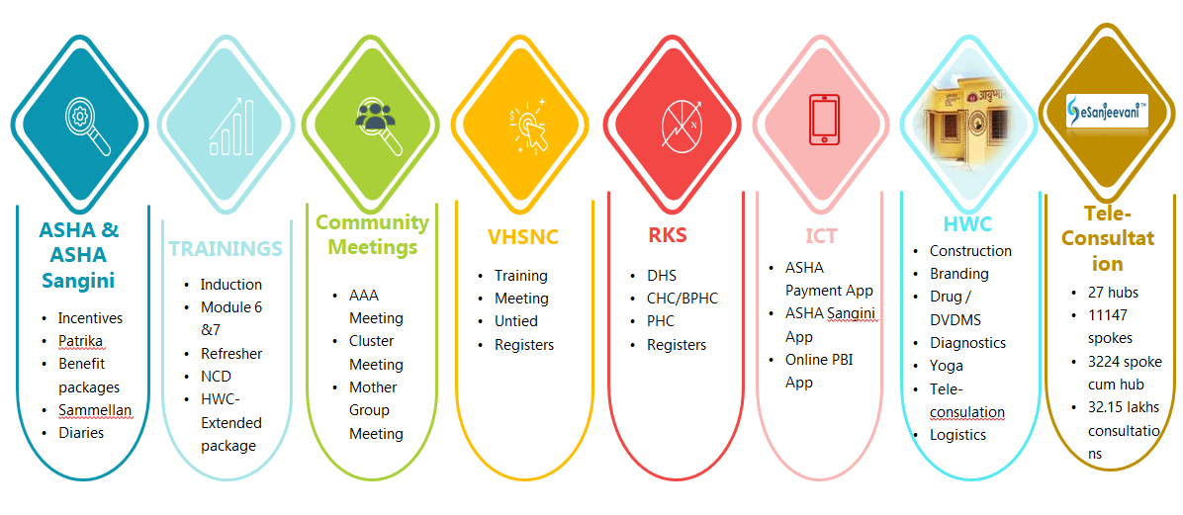
Sub Programs

Slide 75
Human Resources
Targets
Achievements
%
No. of working ASHAs
167059
158362
95
No. of working Urban ASHAs
10625
7176
68
Total ASHAs working in the state
177684
165538
93
No. of ASHA Sangini (working)
8013
7188
90
*Community Health Officer (CHOs)
_____
11356
____
Staff Nurse- MHCP
2486
776
39
Block Community Processes Manager
820
776
94
District Community Processes Manager
75
69
92
Regional Manager- CP
12
11
92
ASHA Resource Centre+ HWC
18
16
89
*SN, LT (2786) and HWC cum CP Assistant (75) are under recruitment

Slide 76
Trends of ASHA Payment

Slide 77



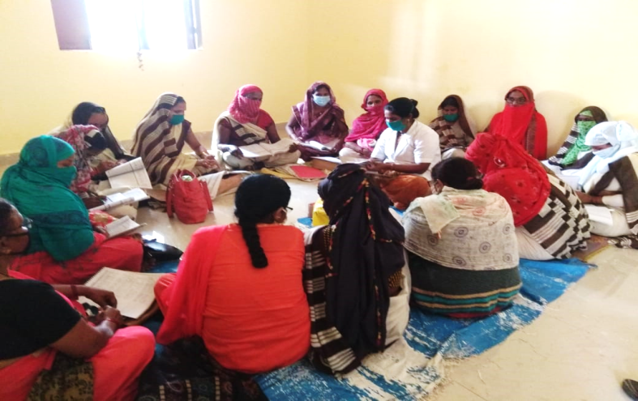
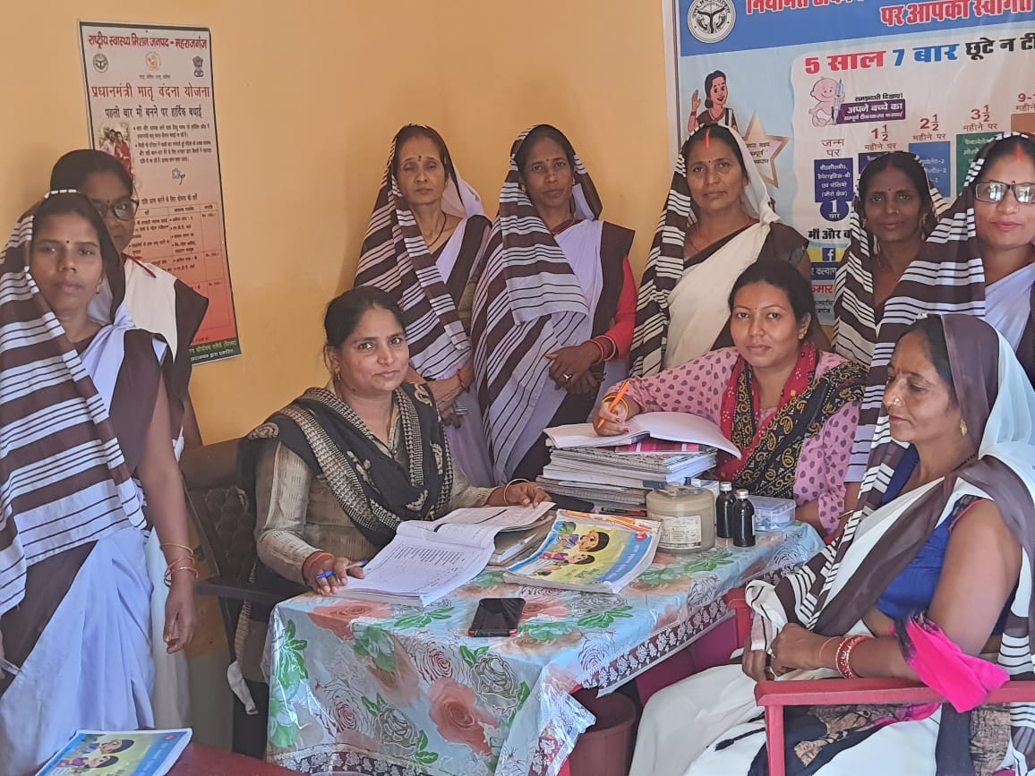
SC Level Meeting (AAA) Key Updates
Introduced AAA Meeting
Expansion in 75 district
Team based incentive at HWC
of ANM, ASHA and AWW in 25 HPDs as review & planning platform to strengthen VHND services
AAA meeting scaled up across the state of Uttar Pradesh
Strengthen SC level meeting at HWC and review based on 15 indicators
2014-15
2016 -18
2020 -2021
Orientation of CHO and ANM on ASHA Yojna, SC Level meeting’s guideline & tracking tool
Define role and responsibility of CHO & ANM based on 15 indicator
ASHA wise report compilation & review by ANM and CHO through tracking tool
Way forward to strengthen SC level Meeting at HWC

Slide 78









Transforming the ASHA Cluster Review Meeting into Cluster Capacity Building & Review Platform
ASHAs and Sanginis suggested for regular capacity building instead of one time class room training.
The recommendation resulted in the transformation of Cluster meeting as ‘Capacity building platform
A module on thematic areas was developed;
ASHA Sangini cadre was trained as facilitators for Cluster Capacity building meeting;
Key Highlights –
3258 Cluster Meetings Transformed as Capacity Building and Review platform.
97% of ASHA sanginis Trained on the Module.
96% of ASHA attendance in cluster meeting across 75 districts in UP.
5696 ASHA Sanginis facilitating sessions as local level trainer

Slide 79


Sangini training completed in 75 districts.
7025 ASHA Sanginis trained on application
6961 Sanginis supporting performance of 156532 ASHAs
Against the 350814 expected HRPs, 2,23,069 HRPs Identified and 171162 follow up by Sanginis
ICT Intervention for ASHA Sanginis
Child Deaths reported by Sanginis
Oct’22 Update
Sangini App Features
Next Steps
Maternal Deaths reported by Sanginis
Training on Dashboard to RMs/DCPMs/BCPMs
Refresher training to Asha Sanginis
Integrating Sangini Incentive Payments with PFMS
Server migration
Continue strengthening and supporting RMs to further support ASHA Sangini performance review and databased decision
Complete Sangini trainings by December 2021
Post training follow-ups with trained Sanginis on use of app
Promote data-based feedbacks and decision making at all the levels
Liking with Digital India
Total deaths reported under Maternal Deaths

Slide 80
Rogi Kalyan Samiti (RKS)
Rogi Kalyan Samiti
DH Level RKS
150
GB Meeting
163
EC Meeting
357
CHC/BPHC Level RKS
1027
GB Meeting
1532
Monitoring
72
EC Meeting
3047
Monitoring
448
Project phase | No. of districts | Health facilities covered |  |  | Total RKS covered | No of RKS members trained
 |  | District Hospital | CHC | UCHC
Pilot | 1 | 10 | 9 | 8 | 27 | 90
First | 10 | 29 | 139 | 0 | 168 | 936
Second | 20 | 40 | 275 | 0 | 315 | 1195
Third | 26 | 50 | 329 | 0 | 379 | 827
Total | 57 | 129 | 752 | 8 | 889 | 3048

Slide 81
Health and Wellness Centres

Slide 82
HWC Conditionality Target Vs Achievements
Facility Category | Conditionality Target up to Dec. 22 | Currently Operational* | Gap Till Dec. 2022
SHCs | 16105 | 11463* | 4642
PHCs | 2727 | 2232 | 495
UPHCs | 592 | 506 | 86
Total | 19424 | 14201 | 5223
*Including 386 State Ayurvedic Dispensaries.
Plan for availability of CHOs as per conditionality target by December -2022 :
CBT examination held on 4th & 7th September 2022 for 5505 CHOs. Considering 80% pass rate from previous batches 4404 CHOs are expected from CCHN training by February 2023.
Also, state is in process of direct recruitment of 4000 CHOs from BSc/PB BSc Nursing integrated institutions, (advertised in October, 2022) considering 60 % conversion rate 2400 CHO’s are expected to join from direct recruitment.

Slide 83

Ensuring Availability of Essential Medicines at HWCs through CHO Led Model
Objective: Ensuring availability of medicines at SHC-HWC with the help of CHOs through DVDMS portal
Guidelines issued to all districts on 07.09.2022
Pilot in Fatehpur with Jhpiego’s Support:
Average no. of medicines increased to 40-45 from earlier average of around 15-18 due to this initiative.
Average cost of transportation per block – Rs. 3200
Challenges :
Packaging delays at warehouse.
Issues in DVDMS portal.

Slide 84



E-Sanjeevani Current Status of Consultations UP
National Rank
6
Hubs
27
Hub cum Spokes 3224
Spokes
11,147
Teleconsultations
32 Lakhs +
Empanelment
3577
Daily Average – 10K +
Source: e-Sanjeevani portal as on 28th October 2022

Slide 85
eSanjeevani team Efforts
Amplifying Active Users
At present 8301 active users providing consultation at eSanjeevani (till 30th October 2022). The tracker of Active users shared with bottom 25 District on daily Basis
Inclusion of 104 in eSanjeevani
Using the 104 platform to escalate the number of Active Users. Sample data set shared with 104 for observing the responses.
Troubleshooting issues
Troubleshooting the issues from ground on daily basis through WhatsApp group, telephonically, Zoom Meeting.
Capacity Building
Total 12000 CHO,MO,RM, Div. PM, ACMO,CMO, Nodal, Medical Education and other concern had trained on eSanjeevniAB portal from April 22- June 22.
Assuring Quality (Keep adequate Information in Portal)
Correction and Update in existing user profile. The related sheet shared with 75 District for Same and the process is ongoing.

Slide 86


Process adopted for roll out of Expanded CPHC Service Packages
State level expert group constituted to roll out Expanded CPHC package and development of training plan and resources
Expert group constitutes representatives from premier institutions, e.g. KGMU,RML,BHU
Considering the pandemic situation in the state, training of Expanded CPHC service packages is being delivered in Blended mode.
Theoretical components are delivered through virtual platform and participants will be linked with district trainers for hands-on training at the nearest facilities (DH/CHC)

Slide 87
Capacity Building on Expanded Range of Services
Sno | Topics | State level training of trainers | Training of Medical officer | Training of CHO | Mode of training
1 | Oral health | Completed | Completed | Completed | Virtual
2 | Elderly & Palliative Care | Completed | Completed | Completed | Virtual
3 | ENT Care | Completed | Completed | Completed | Virtual
4 | Eye Care | Completed | Completed | Completed | Virtual
5 | Mental ,Neurological & Substance Abuse | Completed | Completed | Completed | Virtual
6 | Emergency & Trauma Care | Completed | Completed | Completed | Virtual

Slide 88
Training Update
1 | Oral Health | 120 dentist trained as districts level trainer , 2239 MO (MBBS) & ,10511 CHO were trained in oral Health Care Package . Trainer are from Department of Public Health Dentistry KGMU Lucknow from . Oral health awareness and screening Campaign were launched in the month of August 2022 .
2 | ELDERLY & PALLIATIVE CARE | In total 94 Specialist as District trainer and 808 Medical officers and 6555 CHO were trained in elderly and palliative care,Other than MO & CHO 94 others including RM’s, DCPM etc were also trained on elderly and palliative care Trainers are from Faculties of BHU Geriatric medicine department, and Department of Anaesthesia KGMU lucknow
3 | MENTAL,NEUROLOGICAL& SUBSTANCE ABUSE | A total of approx. ,194 MOs (MBBS) 3,958 CHOs and 122 Staff nurses trained. Further, MO, CHO & Staff nurses will trained ASHA’S & ANM on Mental Health care Service at AB-HWCs
4 | ENT Care (Ear, Nose & Throat) | A total of 920 Medical officer (MBBS) including Urban HWC and 6920 CHO trained on ENT care.
5 | Eye Care | A total of 249 Medical officer (MBBS) including Urban HWC and 4674 CHO trained on Eye care
6 | Emergency Care | A total of 58 Medical officer (MBBS) including Urban HWC and 5672 CHO trained on Emergency,burns and trauma care services
7 | State TOT on expanded package | 63 trainers have been trained in two batches at SHIFW lucknow These Trainers will train 2239 MO & 508 UPHC MO at respective RHFWTC

Slide 89

Expanded Package Roll Out Plan
Training of District Trainers (TOT) In person TOT is planned from 7th November 2022 300 State level trainers will be trained on Mental, Neurological and substance abuse, Eye and ENT Care 300 State level trainers will be trained on Elderly , Pallaiative care and Emergency care services. In total 4 Trainer will be selected from 75 districts (2 MO (MBBS) and 2 SN (MSc. Nursing) with prior experience on training . Training Of CHO In person training will be done by district level trainer Participants CHO & Staff Nurse, training venue will be at District level . 11502 CHO (384 batches) 1035 Staff Nurses (MH-CP) (35 batches) will trained in 30 participants per Batch .

Slide 90









Slide 91
National Urban Health Mission

Slide 92
NUHM
Particulars
Total Population as per census 2011 (in lakhs) | 1,998.12
Urban Population as per census 2011 (in lakhs) | 444.95
Total population covered under NUHM as per census 2011 (in lakhs) | 314.53
Urban slum population (in lakhs) (as per DAP of 2013-14) | 142.88
Total Cities covered under NUHM | 134
Number of Metro Cities | 0
Number of Million + cities (> 10 lakh population) | 7
Number of cities with 1 to 10 lakh | 56
Number of towns with less than 1 lakh but more than 50 thousand population | 62
Number of District HQs which have less than 50 thousand population but are covered under NUHM | 9

Slide 93
Urban Health Facilities
Sl. No | Facility | Approved Till 2021-22 | Approved in 2022-23 | Total Approved | Functional
1. | UPHC | 610 | 100 | 710 | 603
2. | UCHC | 13 | -- | 13 | 11
Health & Wellness Centers
Total approved UPHCs | Approved UPHC HWCs till 2021-22 | Approved UPHC HWCs in 2022-23 | Total Approved HWC | Total HWCs Functional | Remarks
610 | 509 | 101 | 610 | 506 | Recruitment and Retention of MBBS Doctor is a challenge

Slide 94
Human Resources- UPHC
Sl. No | Category | Approved |  |  | In Position
 |  | Till 2021-22 | In 2022-23 | Total Approved | Regular | Contractual | Total
1. | MO | 610 | 100 | 710 | 105/144 | 356/470 | 461/710
2. | Staff Nurses | 1160 | 383 | 1543 | 0 | 847/1543 | 847/1543
3. | LTs | 610 | 100 | 710 | 0 | 424/610 | 424/610
4. | Pharmacists | 610 | 100 | 710 | 0 | 497/610 | 497/610
5. | ANM | 3119 | 500 | 3619 | 80/147 | 2623/2969 | 2703/3116
6. | Program Management Staff (Division/District)
(i) | Div Urban Health Consultant | 18 |  | 18 | 0 | 17 |  | 18
(ii) | District Urban Health Coordinators | 75 |  | 75 | 0 | 61 |  | 61
(iii) | Data Cum Account Assistants | 83 |  | 83 | 0 | 58 |  | 58
(iv) | City Community Process Manager | 41 | 5 | 46 | 0 | 23 |  | 23
(v) | DEO cum Accountants/ | 71 |  | 71 | 0 | 33 |  | 33
Vi | Secretarial Staff for Account Keeping and MIS |  | 616 | 616
VII | Public Health Manager |  | 124 | 124

Slide 95
New Approvals
100 new UPHCs approved in 2022-23
Approval under XV Finance Commission Health Grants
  847 urban HWC
  70 Polyclinics

Slide 96
Nursing cell

Slide 97






CCHN program at a Glance
2. Implementation by PSCs/RHFWTCs/Pvt. MCs
3. Enrolment of CHO trainees by KGMU
4. Setting of question Paper term end exam, result declaration and certification by KGMU
1. Recruitment and selection of candidates by NHM.
5. Funding of course by NHM
Jhpiego is providing technical assistance to overall program

Slide 98

Geographical Spread and Achievements
Current Status of Functional Program Study Centers
Category | Functional
DH, DWH & DCH | 48
Govt. Medical College | 20
Govt. College of Nursing / GNMTC | 8
University/Institute (KGMU/SG PGI) | 2
RHFWTC | 11
Private Non- profit / Medical & Nursing Colleges | 15
Total | 104
104 PSCs in
51 Districts
Program Study Centres
93 PSCs notified and
Operational 11 RHFWTCs
Community Health Officers
Till now 12496 deployed
Current batch of 5505 CHOs through four month CCHN course in process for 2022 – 2023 Session

Slide 99


Establishment of New PSCs in Pvt. Medical / Nursing Colleges
GoI has permitted to establish new PSCs in private medical / Nursing colleges, first time in UP.
A formal letter has sent to all selected Pvt. Medical colleges for baseline assessment and proposal making.
New PSCs assessment and making of proposal based on the KGMU checklists/proforma.
After Scrutiny of proposals by KGMU 14 Pvt. Medical colleges were notified for CCHN training.
Baseline assessment at Era Medical College, Lucknow
Baseline assessment at Heritage Institute of Medical Sciences, Varanasi

Slide 100



Integration of CCH Course with BSc Nursing & PB BSc Nursing
Recruitment Plan & selection modalities-
2814 CHOs were recruited form CCHN Integrated Universities and deployed till March 2022
Total Universities/ Institutions
List of Universities and their Nursing Colleges in Uttar Pradesh has been uploaded in NHM website.
Number of universities | Number of institutions | Expected Output
25 | 110 | 5950
Institutions integrated of CCH Course in UP
Number of universities | Number of institutions | Expected Output
20 | 79 | 4200

Slide 101


New Initiative (CBT exam for selection of CCHN trainees)
Successfully Conducted Computer Based Test (CBT) Approx. 65,000 candidates for the post of 5505 four months CCHN training in UP.

Slide 102



Awards & Achievements

Slide 103


Strengthening of Pre-service Education for Nursing Midwifery Cadre
Skills lab, IT lab and Library established and functional at 12 nursing institutes and 01 in process.
12/13 Nursing institutes strengthened (achieved 70% or above on performance standards).
3 Nodal centres notified by GoI and operational for 6 weeks training of nursing faculty.
124 nursing faculty trained in six weeks training.
78 faculty trained in 6 days DAKSH training at TNAI, Noida.
Previously GNM course was running at 7 GNMTCs, currently 2 new GNMTCs (KGMU Lucknow and CoN Meerut) has been initiated the Course.
Skills lab at SNC, Meerut
Skills lab at SNC Varanasi

Slide 104
Training

Slide 105



Establishment of ANMTCs
After 33 years, 02 years ANM training was started by Hon'ble Chief Minister, Uttar Pradesh on August 10, 2022 in 35 ANM training centers of the state.
1481 trainees are studying in these training centers.
Skills lab, IT lab and Library established and functional at 35 ANMTCs
Regular follow-up is being done by Directorate Training and NHM Officials

Slide 106


Skills Lab, Mentoring & Training
Skills Lab
4 State of art Skill Labs at SIHFW, Lucknow, DCH- Noida, RHFWTC Varanasi and RHFWTC Jhansi has established and fully functional & equipped with skill stations from July, 2022.
These skill labs are being utilized for enhancing capacity building of service provider to provide quality RMNCH+A services.
SBA ToT, Covid training, NBSU ToTs, DAKSH & DAKSHTA trainings are undergoing in these skills labs.
24 Skill lab is proposed to established in 24 College of Nursing of Govt. Medical College.
Creation of these labs, State training capacity has doubled for providing RMNCH+A related trainings
Technical support is being by UPTSU

Slide 107



SBA Training
Initiative taken for development of structured learning resource materials for SBA training on the basis of GoI SBA module and updated guidelines.
914 Specialists/Doctors/Nurse Mentors has been trained as a master trainer (Jan to March 2022).
List of trained personnel's uploaded on NHM website for reference.
93 Ayush LMO and 1107 ANM/Staff Nurse has been trained in SBA in 2021-22.
For current year detailed SBA training micro plan (1196 batches) till March, 2023 has been prepared with support of districts.
Training has been initiated from 1st November, 2022
Nurse mentor’s Training status
773 NMs of total at blocks level on board .
746 NMs DAKSH Trained, 458 NMs DAKSHTA trained, 608 NMs trained in Mentoring methodology.

Slide 108



State Initiative for Capacity building
SIHFW conducted residential 5 days orientation training of all districts CMS training with support of NHM on various important topics like procurement and new NHM activity etc.
SIHFW has planned 12 days residential fundamental training of Medical Officers (Level 1 & 2) in which all health programmes will be covered.
ANM Orientation 12 days residential Training for newly joined ANMs is being planned at district level and 3 days ToT is scheduled from 9th November, 2022 at SIHFW.
Initiated “fundamentals in abdomino-pelvic ultra-sonography: level-one, Six month course” in Government Medical College for PMHS doctors. Total 60 Doctors will be trained in a year.

Slide 109
National Program

Slide 110
National Tuberculosis Elimination Programme (NTEP)
TB Case Notification Status- Total (Public + Private)
Year | Expected | Achievement | % Achieved target
2019 | 251 | 213 | 85%
2020 | 261 | 158 | 61%
2021 | 258 | 193 | 76%
2022 | 230 | 212 | 92%
38% Increase
19 % Increase
Year 2022: data 1st January to 27th Oct
Data as on 28th Oct’2022 as per Nikshay Portal

Slide 111
Month wise Notification Status Year 2019 to 2022
Notification Dec’2019- 34010, Dec’2020-34367, Dec’2021- 35947
Year 2022:Data as on 28th Oct’2022 as per Nikshay Portal

Slide 112
TB Case Notification Status- Public
Year | Expected | Achievement | % Achieved target
2019 | 163 | 143 | 87%
2020 | 163 | 104 | 65%
2021 | 162 | 150 | 97%
2022 | 152 | 156 | 103%
5 % Increase
27 % Increase
Year 2022: data 1st January to 27th Oct
Data as on 28th Oct’2022 as per Nikshay Portal

Slide 113
TB Case Notification Status- Private
Year | Expected | Achievement | % Achieved target
2019 | 88 | 70 | 80%
2020 | 98 | 53 | 56%
2021 | 96 | 52 | 71%
2022 | 78 | 56 | 72%
-10% decrease as compare to Year 2021
Year 2022: data 1st January to 27th Oct
Data as on 28th Oct’2022 as per Nikshay Portal

Slide 114
TB Case detected in ACF Campaigns
Year | Population Mapped | Number Screened | Presumptive TB Case Tested | Diagnosed As TB case
2017 | 11339189 | 12189701 | 87845 | 2656
2018 | 75435905 | 71302155 | 479446 | 21779
2019 | 71011915 | 70238760 | 428042 | 20807
2020 | 9528755 | 9518565 | 42286 | 3080
2021 | 75678836 | 67589470 | 232920 | 25080
2022 (ACF in March +Dastak in July) | 39984380 | 38218174 | 221751 | 11326
Total TB Cases find by ACF Campaigns |  |  |  | 84728

Slide 115
Year 2021- data is 3Q2021, Outcome of 2021 cases is being updated after completion of treatment.
Denominator of UDST :78% of Total notification
Year 2022: data 1st January to 27th Oct
Data as on 28th Oct’2022 as per Nikshay Portal

Slide 116
Nikshay Poshan Yojana for TB patients
Patients getting anti tubercular treatment on or after 1st April’18 are eligible for nutritional support @ Rs 500/- per month to be credited in their bank account through Direct Benefit Transfer
Year/State | Total Notified | % of Bank Details Available | (%) Bank Details Validated | Paid Beneficiary (Total) | % of Paid Beneficiary (Total) | ₹ Paid Amount (Total) | % of ₹ Paid Amount (Total)
2022 (till 27th Oct) | 419067 | 76% | 72% | 249894 | 60% | ₹ 47,04,79,000 | 50%
2021 | 472230 | 80% | 74% | 341405 | 72% | ₹ 88,99,94,500 | 66%
2020 | 380062 | 77% | 65% | 268182 | 71% | ₹ 72,14,06,500 | 64%
2019 | 504194 | 71% | 52% | 328755 | 65% | ₹ 88,63,08,500 | 58%
2018 | 430897 | 63% | 40% | 261789 | 61% | ₹ 71,77,03,500 | 58%
Uttar Pradesh | 2206450 | 73% | 60% | 1450025 | 66% | ₹ 3,68,58,92,000 | 59%
Data as on 28th Oct’2022 as per Nikshay Portal

Slide 117
PMTBMBA Status as on 28th October 2022
State | Ni-kshay Mitra registered | Ni-kshay Mitra agreed upon | Ni-kshay Mitra pending to be agreed upon | Nikshay Mitra Linkage Pendency (%) | TB Patients on Treatment | TB Patients consented | TB Patients Declined | Achievement (%) | TB Patients' consent pending | Consent Pending (%)
U.P. | 18807 | 8231 | 10576 | 56% | 281556 | 234510 | 2722 | 84% | 44324 | 16%

Slide 118
National Vector Borne Disease Control Programme (NVBDCP)
S.no. | Component | Target | Achievements
1 | Malaria | -Annual Blood Examination Rate (ABER) -10%, | ABER-3.2% (Up to September 2022 against the target 7.75)
 |  | -Annual Parasite Incidence (API) below 1% | API – 0.02 up to Sep. 2022 (No District have API >1)
2 | Kala-Azar (Endemic in 6 districts) | Focusing on Elimination having less than 1 case per 10000 population. | Target achieved at block level.
3 | Lymphatic Filariasis (50 Districts) | -Population coverage- 85% of targeted population for MDA | Mf rate at present is below 1% (0.30)
 |  |  | 01 District (Rampur) has passed Transmission Assessment Survey, 50 districts remaining.
4 | Dengue & Chikungunia | -Reduce/sustain case fatality rate for Dengue at <1% | CFR for dengue is <1% is achieved and sustained in year 2022.
 |  | Number of Sentinel site hospitals to be set up (1 per district) | 02 ARL & 68 SSH labs in 57 Districts (2022). SSH Labs in rest of Districts to be established in phase manner after getting approval from NCVBDC GoI, at least 1 SSH lab in all 75 Districts (2024).

Slide 119
Districts with ABER > 3 upto September 2022 (MALARIA)
S. No. | Name of District | Population | Upto September 2022 |  |  |  | ABER
 |  |  | BSE | Positive | P.f. | R.T.
1 | Amethi | 2266862 | 148941 | 0 | 0 | 0 | 6.57
2 | Chitrakoot | 1168313 | 58172 | 3 | 0 | 3 | 4.98
3 | Badaun | 3765012 | 176582 | 661 | 81 | 661 | 4.69
4 | Mirzapur | 2941972 | 128651 | 102 | 0 | 102 | 4.37
5 | Sonbhadra | 2196704 | 95165 | 235 | 12 | 235 | 4.33
6 | Saharanpur | 4085599 | 173967 | 0 | 0 | 0 | 4.26
7 | Bulandshahar | 4126026 | 174475 | 13 | 0 | 13 | 4.23
8 | Mahoba | 1033191 | 42974 | 0 | 0 | 0 | 4.16
9 | Mathura | 2997828 | 123486 | 7 | 0 | 7 | 4.12
10 | Ghaziabad | 3984389 | 157068 | 17 | 0 | 17 | 3.94
11 | Bareilly | 5266283 | 207366 | 1474 | 203 | 1474 | 3.94
12 | Kanpur Nagar | 5393192 | 210680 | 5 | 0 | 5 | 3.91
13 | Aligarh | 4332819 | 167507 | 31 | 0 | 31 | 3.87
14 | Banda | 2122321 | 80902 | 11 | 0 | 11 | 3.81
15 | Etah | 2077046 | 77778 | 35 | 0 | 35 | 3.74
16 | Jalaun | 1970391 | 70002 | 1 | 0 | 1 | 3.55
17 | Lalitpur | 1436472 | 50345 | 0 | 0 | 0 | 3.50
18 | G.B.Nagar | 1975104 | 66618 | 82 | 1 | 82 | 3.37
19 | Hamirpur | 1302046 | 42345 | 14 | 0 | 14 | 3.25
20 | Lucknow | 5411476 | 163166 | 72 | 0 | 72 | 3.02
21 | Kannauj | 1955398 | 58660 | 10 | 0 | 10 | 3.00

Slide 120
Year wise Dengue cases & CFR in Uttar Pradesh
Notes:
Key Deliverables under NHM 2022-24 :-
Reduce/sustain case fatality rate for Dengue at <1%
Number of functional Sentinel site hospitals to be set up (1 per district)
Early notification of Dengue cases

Slide 121
Dengue & Chikungunya Surveillance strengthening
2020
46-SSH Labs & 1-Apex Lab (38 districts)
2022
68-SSH Labs & 2-Apex Lab (57 districts)
2021
54-SSH Labs & 2-Apex Lab (47 districts)
2018
45-SSH Labs-& 1-Apex Lab (38 districts)
2017
36-SSH Labs & 1-Apex Lab (29 districts)

Slide 122

Status of AES / JE Disease & CFR (%)

Slide 123
AES / JE
YEAR | AES |  |  | CONFIRMED JE CASES |  |  | % OF JE CASES OUT OF TOTAL AES CASES
 | TOTAL CASES | TOTAL DEATHS | CASE FATALITY RATE (CFR %) | CONFIRMED JE CASES | JE DEATHS | CASE FATALITY RATE (CFR %)
2016 | 3911 | 641 | 16.39 | 442 | 74 | 16.74 | 11.30
2017 | 4724 | 655 | 13.9 | 693 | 93 | 13.4 | 14.7
2018 | 3077 | 248 | 8.0 | 329 | 30 | 9.1 | 10.7
2019 | 2185 | 126 | 5.77 | 235 | 21 | 8.94 | 10.76
2020 | 1646 | 83 | 5.04 | 100 | 9 | 9.00 | 6.08
2021 | 1701 | 58 | 3.41 | 153 | 5 | 3.27 | 8.99
2022 (27-10-2022) | 868 | 20 | 2.30 | 86 | 2 | 2.33 | 9.91

Slide 124
National Viral Hepatitis Control Programme (NVHCP)
Model Treatment centers -6 (govt.) Medical colleges
Treatment centers - 75
State Reference Lab (for viral load testing)- 6 (govt.) Medical colleges
Viral load testing other than State reference lab- 23
Collaboration with blood bank, ICTC and ART Centers for referring co morbid patients under NVHCP.

Slide 125
Hepatitis C
Hepatitis B
Total number of persons screened for hepatitis C= 816016
Total number of persons tested positive = 35541
Total number of patients put on treatment = 28264
Total no. of patients completed treatment = 14446
Total number of Person screened for hepatitis B= 37,73,850 (Including ANC)
Total number of person tested positive in Screening = 17847
Total number of patients put on treatment = 2194

Slide 126
Integrated Disease Surveillance Programmen(IDSP)
Details of contractual positions filled at State/District level
State Surveillance Unit (State HQ)
S.N. | Designation | Status of Positions | Training Status
1 | EPIDEMIOLOGIST | Filled | Yes-(RRT at NIHFW in Feb. 2016);
2 | MICROBIOLOGIST | Filled | Yes-at Pune (Jan., 2016)
3 | VETERINARY CONSULTANT | Filled | -
4 | ENTOMOLOGIST | Filled | Yes-1.at NIHFW (RRT, in Feb., 2016) 2.-VCRC, Pudducherry of Entomology
5 | DATA MANAGER | Vacant | Yes-At NCDC (2014)
6 | DATE ENTRY OPERATOR (DEO) | Filled | Yes
7 | TRAINING CONSULTANT | Filled | -
8 | FINANCE CONSULTANT | Filled | -
District Surveillance Unit (District HQ)
S.N. | Designation | Total Sanctioned | Total In-position | Total Vacant | Training Status
1 | EPIDEMIOLOGIST | 75 | 65 | 10 | 60
2 | MICROBIOLOGIST | 2 | 2 | 0 | 0
3 | DATA MANAGER | 75 | 63 | 12 | 60
4 | DATE ENTRY OPERATOR (DEO) | 75 | 67 | 8 | 57
5 | DATE ENTRY OPERATOR (DEO) at 10 identified Govt. Medical Colleges | 10 | 7 | 3 | 5

Slide 127
Reporting status of From S, P and L in 2021 and 2022
Week No: 01-42
Year | Form | Total Number of Reporting Units (RUs) identified by State | Number (%) RUs Reporting
2021 | Presumptive Form (P) | 5210 | 15.03%
 | Laboratory confirmed Form(L) | 3228 | 11.84%
 | Syndromic Form (S) | 20849 | 5.16%
2022 (till 27.10.2022) | Presumptive Form (P) | 4723 | 25.24%
 | Laboratory confirmed Form(L) | 4512 | 23.28%
 | Syndromic Form (S) | 20991 | 12.30%

Slide 128
Status of Reporting of Disease Outbreaks on IDSP Portal (from districts of U.P.)
Year wise (Year 2014 to 2022 Comparative) no. of disease outbreaks / Early Warning Signals (EWS) reported on-line from districts on portal of IDSP are as given below:-
Outbreaks / EWS reported on IDSP portal from districts of UP
Year 2014 to 2022 (till 31.10.2022) Comparative
Year 2014 | Year 2015 | Year 2016 | Year 2017 | Year 2018 | Year 2019 | Year 2020 | Year 2021 | Year 2022
172 | 408 | 529 | 463 | 237 | 221 | 21 | 156 | 159

Slide 129
NLEP UP
as on September, 2022
SN | Indicators | U.P. | Chitrakoot | Maharajganj
1 | No. of balance cases under treatment | 9384 | 45 | 179
2 | Annual New Case Detection Rate per 1,00,000 population | 5.98 | 4.20 | 7.56
3 | Prevalence Rate per 10,000 population | 0.39 | 0.38 | 0.56
4 | Child among new cases (%) | 1.77 | 00 | 0.83
5 | Grade II disability among new cases (%) | 0.67 | 00 | 1.65
6 | Deformity rate per 10,00,000 population at state level | 0.40 | 00 | 1.25

Slide 130
Non Communicable Diseases

Slide 131
National Programme for Control of Blindness & Visual impairment
Goal
Prevalence rate of blindness in Uttar Pradesh is 0.36%. Goal of the programme is to reduce prevalence rate of blindness to – 0.25% by the end of year 2025.
Main Activities
Cataract Surgery.
School Eye Screening.
Eye banking for keratoplasty to treat Corneal Blindness.
Management of diseases other than Cataract (Diabetic Retinopathy, Glaucoma management, Laser Techniques, Corneal Transplantation, Vitreoretinal Surgery and treatment of Childhood blindness)

Slide 132
Status of Cataract Operation in U.P. Till Sep-2022
Cataract Operation | Year 2021-22 | Till Sep, 2022-23
Annual Targets | 11,36,000 | 11,36,000
Total Operations (Govt.+ NGO+Pvt.) Till Sep, 2022 | 873601 | 252598
Status of Cornea Collection in U.P. Till Sep-2022
Cornea Collection | Year 2021-22 | Till Sep, 2022-23
Annual Targets | 1500 | 1500
Total Operations (Govt.+ NGO+Pvt.) Till Sep, 2022 | 1235 | 391

Slide 133
Status of School Eye Screening & Free Spectacles in U.P. Till Sep, 2022
Free School Eye Screening | Year 2021-22 | Till Sep, 2022-23
Annual Targets | 50,00,000 | 50,00,000
Achievement Till Sep, 2022 | 1039956 | 1150761
Free Spectacles Distribution | Year 2021-22 | Till Sep, 2022-23
Annual Targets | 2,00,000 | 2,00,000
Achievement Till Sep, 2022 | 43640 | 8318

Slide 134
National Mental Health Programme
Program is being implemented in 75 Districts of Uttar Pradesh.
Aim
Prevention and treatment of mental and neurological disorders and their associated disabilities.
Use of mental health technology to improve general health services.
To increase awareness about mental illness through change of attitude and public education.
Achievements & Initiatives
Man-Kaksh (District Counselling Centre) has been Established in 64 districts of U.P.
03 Days OPD Services has been started in all 75 districts of U.P.
A new initiative named “Dua Se Dawa” has been started in 40 Districts of U.P. (Screening & Treatment of Patients with the support of Faith healers)
Training of Medical officers in “Psychiatry” . (One Month Training in Psychiatry).
Training of Counsellors & other Paramedical Staff in Psychiatry. (One Month Training in Psychiatry).

Slide 135
National Tobacco Control Program
Coverage of District: 75 Districts are covered in FY 2022-23
GoI has approved NTCP programme in 75 districts of U.P.,
Activities :-
School Programme
Pharmacological Treatment
Establishment of Tobacco Cessation Centre (TCC)
Training/ Sensitization Programme
BCC/IEC campaign
State Tobacco control cell Govt. of UP got WHO south East Asia region award on occasion of world No Tobacco Day 2021 awards.

Slide 136
Physical Progress under NTCP
SN | Key Performance Indicators (KPIs) | April, 2021 to March, 2022 | April, 2022 to June, 2022 | % of target Achieved
1 | No. Of person Penalised & Amount Collected | Person 2303 Rs. 312021/- | Person 1458 Rs. 156278/- | There is No “assigned target” for the programme.
2 | No. of trainings/sensitization programmes for different stakeholders | 191 | 69
3 | No. of participants in the trainings/sensitization programmes | 17167 | 3451
4 | No. of School programmes | 5259 | 767
5 | No. of person counselled at TCCs | 54712 | 27013

Slide 137
National Programme for Prevention & Control of Deafness (NPPCD)
Coverage of District:
All 75 Districts are covered in Year 2022-23.
Proposed Activities :-
NPPCD Monitoring cell at Directorate level.
Manpower at district level.
IEC at District & state level.
Procurement of bio-medical and other equipments at State level (UPMSCL).
The person identified as being deaf are provided with Hearing Aid by Handicap Welfare Department under ADIP Scheme of GOI.
Training of ENT surgeons, pediatricians & Gynecologist, Medical Officer & Block level.

Slide 138
National Iodine Deficiency Disorder Control Programme
Activities
Testing of salt samples for Iodine content by Salt by ASHAs at house hold level in districts with STKs (salt testing kits)
IEC Activities at
State level & District Level
Quantitative estimation of Iodine content in salt samples in State Health Institute (SHI) received from districts
24 Endemic Districts of State are cover under NIDDCP.
Quantitative Test (Titration Method) by ASHA F.Y. 2021-22 Samples by STK 3384003 by ASHA & F.Y. 2022-23 till September Samples by STK 7272386 .
Quantitative Test (Titration Method) by SHI Aliganj Lucknow F.Y. 2021-22 Samples by STK 617 by ASHA & F.Y. 2022-23 till September Samples by STK 2051.

Slide 139
NPCDCS

Slide 140
National Programme for Prevention and Control of Cancer, Diabetes, Cardiovascular Diseases and Stroke (NPCDCS) -New
Targets 2022-23:-
GoI has approved NPCDCS Programme for 75 districts of U.P., Presently district NCD Cell are functional in 62 districts & NCD clinic are functional in 62 districts.
CHC NCD Clinic are Approved for 427 CHC, 332 functional.
Cardiac Care Unit are Approved 7 and 4 functional.
Opportunistic screening of 30+ aging populations and pregnant women in the health care delivery system at 11461 Sub Centres & 3621 PHC for early detection of diabetes, hypertension and common cancers are carried out. At 11139 Sub centre level NCD app implemented for screening data monitoring.
Total no. of NCD screening in FY 2020-21 – 1490587 (2.01,%)
Total No. of NCD screening till September, 2021 - 7731741 (10.45 %)
Total No. of M.O. trained in Population Based Screening districts - 625
Total No. of Staff Nurse trained in Population Based Screening districts - 883
Total No. of CHO trained in Population Based Screening districts - 11139
Total No. of ANM trained in Population Based Screening districts – 7571
Total No. of ASHA trained in 20 Population Based Screening districts- 47567

Slide 141
Physical report till August, 2022 under NPCDCS-new
S.No | Indicator | Number
1 | Total No. of Patients attended NCD clinic | 1758937
2 | No. Newly diagnosed with
i | Diabetes | 236808
ii | Hypertension | 192715
iii | CVDs | 8010
3 | No. of New patients initiated on treatment
i | Diabetes | 178562
ii | Hypertension | 141705
iii | CVDs | 6137
4 | No of persons counseled for Health Promotion and Prevention of NCDs | 537631
5 | No. of Patients attended for Physiotherapy | 117311

Slide 142
Management Information system

Slide 143
Operational Activities With Scope
Sr. No | Activity Name | Details with scope
1 | HMIS Portal 2.0 | Run and maintained by MoHFW and required data entry/updation for infrastructure and Monthly service delivery details on part of every Health Facility done from whole state on monthly interval. Source data for DH Ranking, CHC-PHC grading, PM Dashboard, NITI Aayog etc. and conditionality. In FY 2022-23, average 99.37% public health facilities reported Monthly MIS data upto Sep 22 as well as 99.40% health facilities reported infrastructure data.
2. | RCH Portal & ANMOL App Rollout | RCH Portal is currently operational in whole state. Run and maintained by MoHFW and required expected Mother, Child and Mother data entered from all blocks of State collected and compiled by Health Workers as ASHA & ANMs. In FY 2022-23 as on 31.10.2022, registration coverage of pregnant women is 41.29% and children is 41.12%. ANMOL Application implemented in all districts of state.

Slide 144
Operational Activities With Scope
Sr. No | Activity Name | Details with scope
3 | DVDMS | A web based drug supply chain management application deals with Purchase, Inventory Management & Distribution of various drugs, vaccines, sutures and surgical items to various District Drug Warehouses (DWH) and Public Health Facilities of State (DH their sub stores like CHC and PHC) operational in all District HQ level from July 2017. Operational implementation of same facility up to CHC/PHC/BPHC/UPHC and 10,000 HWC center has been completed and rest of HWC has been process in Financial Year 2022-23. 434 number of Centralized Purchase order generated for RS 231.42 crore till 2nd Nov, 2022 for 75 CMO’s, 167 District Hospitals,75 warehouse & 18 Divisions in fy 22-23.
4 | IT System for Comprehensive Primary Health Care (CPHC) & eKavach Mobile Platform | Comprehensive primary health care domain in context with public health is almost similar in each state but the process implementation through Field Level Health Worker/health facility staff may vary from state to state. The eKavach Application is a work flow based system and it is customized to synchronize with Field Level Health Workers/Facility Staff work flow in state of Uttar Pradesh. The solution is expected to ultimately serve as the single interface for all CPHC needs with several innovations and integrations with other relevant platform (RCH/HMIS Portal/HMIS Solution/NCD Portal/Mantra App etc) and be compliant to National Standards and ABHA requirements. All of this shall ensure timely service delivery, greatly reduce gaps in Follow ups, quick identification of High Risk and its resolution and contribute positively to all the key SDG 3 Indicators including IMR, MMR and Sex Ratio at Birth.
5 | Centralize Cloud Platform | NHM-UP has implemented cloud based IT Systems implementation for IT Applications/Systems rolled out for various NHM-UP activities in FY 2022-23. Till date 09 IT Systems shifted to cloud plateform.

Slide 145
HMIS Key Performance Indicators
RCH Portal Progress
Key Performance on HMIS Portal FY 2022-23 (Upto Sep22 as 02.11.2022) | Uttar Pradesh
% of ANC Registration against Estimated Pregnancy (upto Sep 22) | 104.86%
ANC Registered within Ist Trimester against Estimated Pregnancy (upto Sep 22) | 71.86%
% 4 or more ANC check ups against Estimated Pregnancy (upto Sep 22) | 87.54%
% of Institutional Deliveries conducted against Estimated Delivery (upto Sep 22) | 53.95%
Sex Ratio at Birth (upto Sep 22) | 923
% of Fully Immunized against Estimated Infants (upto Sep 22) | 93.37%
Allopathic- Outpatient attendance (upto Sep 22) | 54935795
Ayush - Outpatient attendance (upto Sep 22) | 6339226
Total IPD (upto Sep 22) | 3140087
Number of Lab Tests done (upto Sep 22) | 57086266
RCH Portal Progress of 08 Key Indicators (State Summary) ( FY 2022-223)
SN | 08 Key Indicators | Current Progress 31.Oct.2022
1 | Pregnant Women Registration | 41.29%
2 | Child Registration | 41.12%
3 | Child Full Immunization | 52.45%
4 | Full ANC | 45.06%
5 | Delivery | 48.72%
6 | Institutional Delivery | 47.86%
7 | Pregnant Women Registered in 1st Trimester | 70.93%
8 | HRP (High Risk Pregnancy) | 7.67%

Slide 146









E-Kavach Application
Application Modules
Module 1: Enumeration (Family Survey); Migration, Merge & Split of the Family
Module 2:
RCH Module
Module 2.1
Eligible couples for
Family Planning
Module 2.2
Antenatal Care (ANC)
Module 2.3
Pregnancy Outcome
(Abortion & Delivery)
Module 2.4
Post Natal Care (PNC)
Module 2.5
Child Health
Module 2.6
Death (Maternal
& Child)
Module 3:
Facility Module
Module 4: NCD
APPLICATION PROCESS

Slide 147




BENEFITS OF THE APPLICATIONS
Longitudinal, digital tracking of pregnant women, child health status and services
High Risk Pregnancy Tracking and Management
Scheduling and planning for FLWs
Digital due list for FLWs
Videos for Counseling
Availability of real time information for immediate action
Broadcasting key health related message
Reminders to FLWs for their visits
Alerts for users
VHIR-
Total Families Registered on e-Kavach Application: 75,27,573
Total Members Registered on e-Kavach Application :2,94,10,187
Total ABHA ID Generated through e-Kavach Platform:- 7,91,034

Slide 148
EMERGENCY MEDICAL TRANSPORT SYSTEM

Slide 149
Overview
State is operating 2200 Ambulances under 108 Ambulance Service.
Total 2270 Ambulances are operating under 102 National Ambulance Service.
250 Ambulances are operating under ALS Ambulance Services.
Services are through private service provider GVK EMRI, toll free number, centralized call centre and GPS fitted 108 & 102 BLS Ambulances.
Services of ALS Ambulances are through private service provider MedCare 365 Pvt. Ltd.
Each Ambulance is manned with a pilot and Emergency Medical Technician(EMT).
170 NMMU operational in 53 districts. Services are through private service provider KHG.

Slide 150

108 Ambulance Service
2200 ambulances operational (1517 ambulances in the East cluster and 683 ambulances in the West cluster).
Response time of 15 minutes kept in new agreement.
Service available free of cost to people in case of any medical emergency in all districts of state.
The patient is transported to the nearest government health facility. If required intra-district and inter-district inter-facility transfers are done after referrals by competent officers.
If needed medical assistance is provided at site as well as during transit by Ambulance staff.
Till now near about 2.13 Crore patients have been benefitted by this service.

Slide 151

102 National Ambulance Service
Total 2270 ambulances operational.
Service is free of cost to beneficiaries of JSY and JSSK in all districts of state.
After call on 102 the Ambulance has to reach the patient within 20 minutes in URBAN and 30 minutes in RURAL areas.
Beneficiary is provided transport facility to the nearest government health facility as well as inter-facility transportation and drop back.
If needed medical assistance is provided at site as well as during transit by Ambulance staff.
Till now near about 5.72 crore patients have been benefitted by this service.

Slide 152

ALS Ambulance Service
Service started on 13 April 2017.
Presently 250 ambulances operational.
Provide referral transportation to critical
patients to higher facilities
Trained EMT and medicine necessary for
critical patients available in ambulance.
Provide referral transportation to critical
patients to higher facilities
Advance equipments like ventilator,
defibrillator, cardiac monitor, etc available in ambulances for critical care during transportation.
Patients can also be transported to AIIMS New Delhi and PGI Chandigarh from neighboring districts (within 200 km)
About 4.32 Lakhs patients transported across state till now.

Slide 153

Mobile Medical Units
MMU
170 operational NMMU in 53 districts.
Average 64 Patient catered & average 10 Lab test performed in each trip.
Average 24 trips per MMU per month.
Each service point location is revisited after 15 days.
Till now near about 89.80 Lakhs patients have been benefitted by this service.

Slide 154
Finance

Slide 155
National Health Mission, Uttar Pradesh
Sl. No. | Particulars | Amount (Rs. in Crore)
1 | Total Resource Envelop of FY 2022-23 Including Unspent Balance as on 01-04-2022 Rs. 5,813.74 | 13,475.34
2 | Total available fund | 7,307.66
3 | Expenditure upto October, 2022 (including advances ) Rs. 657.77 Crore | 3518.42

Slide 156

Fund Utilization Status (Rs. in Crore)

Slide 157
SNA System & Banking Arrangement
All bank accounts under NHM are being operated under joint signature
Separate bank account for Non-NHM funds has been opened
Separate bank account for Rogi Kalyan Samiti are being maintained at health facility level
Funds of NHM has not been kept in Fixed deposit/Term Deposit account.
From 1st April, 2015 all payments except statutory deduction like TDS shall be made through PFMS Portal and no payment through cheque shall be allowed
SNA system has been implemented in Uttar Pradesh. State Nodal Account (SNA) and Zero Balance Subsidiary Account (ZBSA) of all Implementing agencies has been opened in State Bank of India
Funds has been taken back in SNA account from Implementing agencies (upto Block Level)
Limits are being issued to implementing agencies for execution of approved activities of National Health Mission

Slide 158
Issues on PFMS & SNA
State is unable to register IA bank account on PFMS, due to which state is making state level payment from SNA bank account of the state Health Society while point 18 of OM dated 23.3.2021 regarding implementation of SNA system provides that-
Payments will be made from the zero balance subsidiary accounts upto the drawing limit assigned to such accounts from time to time. Transactions in each subsidiary account will be settled with the Single Nodal Account daily through the Core Banking Solution (CBS) on the basis of payments made during the day
DBT reports are not being generated on PFMS

Slide 159
Financial and Account Management System (FAMS)
With a view to establishing a sound financial management system in Uttar Pradesh, FAMS has been implemented from 1st April, 2021 up to Block level for capturing all Financial Transaction
FAMS includes Accounting, Budgeting (DHAP), grant and release, MIS & Audit Modules.
On-line availability and accessibility of all reports, schedules, and balance sheets
Integrated & automatic consolidation of accounting and reporting at district and state level.

Slide 160

Districts NHM Expenditure (%) & Balance 1-4-2022 to 31-10-2022

Slide 161
Construction

Slide 162
STATUS OF WORKS UNDER NHM
Type of Facilities and equivalent |  | New Constructions |  | Renovation/ Up gradation
 |  | Sanctioned | Completed | Sanctioned | Completed
200 Bedded MCH Hospital | (2012-13) | 1 | 1 | - | - | All work completed
 | (2013-14) | 5 | 5 | - | -
MCH Wings (100 Bedded) (DWH/Medical College Campus) | (2012-13) | 52 | 52 | - | - | All work completed
 | (2017-18) | 1 | 1 | - | -
 | (2018-19) | 1 | - |  |  | Work is in Progress (JN Medical College, AMU Aligarh)
MCH Wings (50 Bedded) (CHC Campus) | (2012-13) | 12 | 12 | - | - | All work completed
 | (2016-17) | 12 | 9 | - | - | 9 Works completed. 2 Works is in progress. 1 Land (Khatauli Dist Muzaffernagar) not Available) Target of Completion December 2022
MCH Wings (30 Bedded) (CHC Campus) | (2012-13) | 78 | 78 | - | - | All work completed
Total |  | 162 | 158

Slide 163
STATUS OF WORKS UNDER NHM
Type of Facilities and equivalent |  |  | New Constructions |  | Renovation/ Upgradation |  | Remarks
 |  |  | Sanctioned | Compl. | Sanctioned | Compl.
CHC | (2009-10) |  | 33 | 32 | - | - | 1 Nos. Court Stay (Kuthaund Jalaun)
 | (2009-10) |  | - | - | 50 | 50 | Up gradation up to IPHS Norm
 | (2012-13) |  | 15 | 15 | - | -
 | (2015-16) |  | 17 | 16 | - | - | 1 work (Kemri Dist Rampur) land not available.
 | (2016-17) |  | 9 | 8 | - | - | 1 work (Bhiti Dist Prayagraj) is in progress & Target of completion December 2022
Total |  |  | 74 | 71 | 50 | 50
PHC | (2009-10) |  | - | - | 942 | 942 | JSY Ward, All works is complete
 | (2012-13) |  | 28 | 28 | - | - | All works is complete
 | (2016-17) |  | 4 | 4 | - | - | All works is complete
Total |  |  | 32 | 32 | 942 | 942
Trauma Wing |  | (2013-14) | 10 | 10 | - | - | All works is complete
AYUSH Wing |  | (2012-13) | 84 | 71 | - | - | All works is complete 13 Nos. not committed.
Total |  |  | 94 | 81 | - | -

Slide 164
STATUS OF WORKS UNDER NHM
Type of Facilities and equivalent |  | Ne8w Constructions |  | Renovation/ Upgradation |  | Remarks
 |  | Sanctioned | Completed | Sanctioned | Completed
SUB CENTER | (2008-09) | 1142 | 1028 | - | - | Executed through Gram Panchayat (DHS)
 | (2008-09) | - | - | 500 | 482 | 18 Works uncommitted (DHS)
 | (2009-10) | 2908 | 2900 | - | - | 5 No. stopped due to court stay & Rest 3 uncommitted
 | (2010-11) | 1756 | 1250 | - | - | 394 is in Progress. 112 nos. uncommitted.
 | (2012-13) | 412 | 308 | - | - | All works completed & 104 uncommitted (DHS)
 | (2013-14) | 350 | 342 | - | - | 3 No. stopped due to court stay & Rest 5 uncommitted
Total |  | 6568 | 5828 | 500 | 482
State Drug Ware House | (2016-17) | 1 | 1 | - | - | work completed.
Regional Drug Ware House | (2010-11) | 7 | 7 | - | -
 | (2012-13) | - | - | 11 | 10 | 1 Work uncommitted
Total |  | 8 | 8 | 11 | 10

Slide 165
STATUS OF WORKS UNDER NHM
Type of Facilities and equivalent |  | New Constructions |  | Renovation/ Upgradation |  | Remarks
 |  | Sanctioned | Completed | Sanctioned | Completed
District Drug Ware House | (2009-10) | 30 | 30 | - | - | All work is completed.
 | (2012-13) | 22 | 16 | - | - | 6 Nos. uncommitted
 | (2012-13) | - | - | 23 | 20 | 3 Nos. uncommitted
 | (2015-16) | 2 | 2 | - | - | All work completed.
 | (2016-17) | 1 | 1 | - | - | work completed.
 | (2020-21) | 25 |  |  |  | 23 works is in progress. 2 places Hapur & Shamli Re-Tender is in process. Completion Period -18 Months
 | (2021-22) | 50 |  |  |  | 38 Works is in progress. 3 Works Demolition required. 4 works land not Available. 1 work court stay. 1 work land dispute. 3 works about to start. Completion Period -18 Months
Total |  | 130 | 49 | 23 | 20
RFPTC | (2009-10) | - | - | 11 | 11 | All work completed.
 | (2012-13) | - | - | 11 | 11 | All work completed.
Total |  | - | - | 22 | 22
ANMTC | (2009-10) | - | - | 4 | 4 | All work completed.
 | (2012-13) | - | - | 40 | 37 | 3 nos uncommitted
Total |  | - | - | 44 | 41
DH (Dist Varanasi) | (2017-18) | - | - | 3 | 3 | All work completed
Total |  | - | - | 3 | 3

Slide 166
STATUS OF WORKS UNDER NHM
Type of Facilities and equivalent |  |  |  | New Constructions |  | Renovation/ Upgradation |  | Remarks
 |  |  |  | Sanctioned | Completed | Sanctioned | Completed
Urban CHC | (2016-17) |  |  | 1 | 1 | - | -
 | (2018-19) |  |  | 1 | - | - | - | Site development work is in progress. Target of Completion is Dec 2022
Total |  |  |  | 2 | 1 | - | -
Urban PHC | (2016-17) |  |  | 3 | 3 | - | - | All Work Completed
 | (2017-18) |  |  | 1 | 1 | - | - | Work Completed
Total |  |  |  | 4 | 4 | - | -
ART Center |  | (2019-20) |  | 1 | 1 | - | - | Work Completed
 |  |  |  | 1 | 1 | - | -
Comprehensive Medical, Surgical and Accidental Emergencies Unit |  |  | (2020-21) | 7 | - |  |  | 4 works is in progress. 2 Works land not Available. 1 work place change work to be started. Target of Completion 15 Months
 |  |  | (2021-22) | 3 | - |  |  | 2 works is in progress. . 1 work to be started Works completed in 15 Months
 |  |  |  | 10 | -

Slide 167
STATUS OF WORKS UNDER NHM
Type of Facilities and equivalent |  |  |  | New Constructions |  | Renovation/ Upgradation |  | Remarks
 |  |  |  | Sanctioned | Completed | Sanctioned | Completed
Urban CHC | (2016-17) |  |  | 1 | 1 | - | -
 | (2018-19) |  |  | 1 | - | - | - | Site development work is in progress. Target of Completion is Dec 2022
Total |  |  |  | 2 | 1 | - | -
Urban PHC | (2016-17) |  |  | 3 | 3 | - | - | All Work Completed
 | (2017-18) |  |  | 1 | 1 | - | - | Work Completed
Total |  |  |  | 4 | 4 | - | -
ART Center |  | (2019-20) |  | 1 | 1 | - | - | Work Completed
 |  |  |  | 1 | 1 | - | -
Comprehensive Medical, Surgical and Accidental Emergencies Unit |  |  | (2020-21) | 7 | - |  |  | 4 works is in progress. 2 Works land not Available. 1 work place change work to be started. Target of Completion 15 Months
 |  |  | (2021-22) | 3 | - |  |  | 2 works is in progress. . 1 work to be started Works completed in 15 Months
 |  |  |  | 10 | -

Slide 168

National Health Mission, Uttar Pradesh

